Slide 1
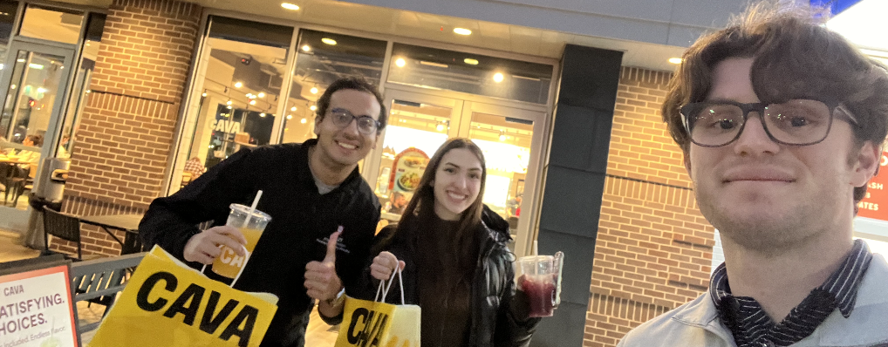



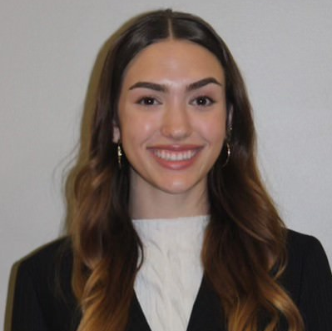
CAVA “Harissa” Growth Strategy Plan
KU 2026 National Case Competition | Team Harissa (17)
Fares Hajji
Oliver Cogan
Jayci Nasser

Slide 2
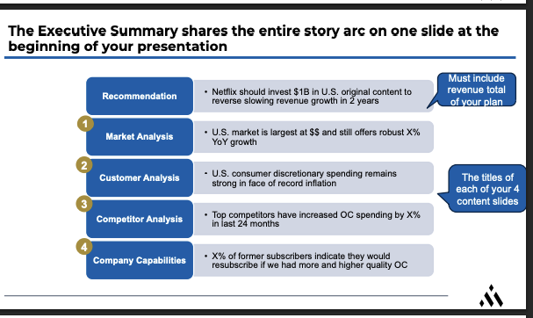
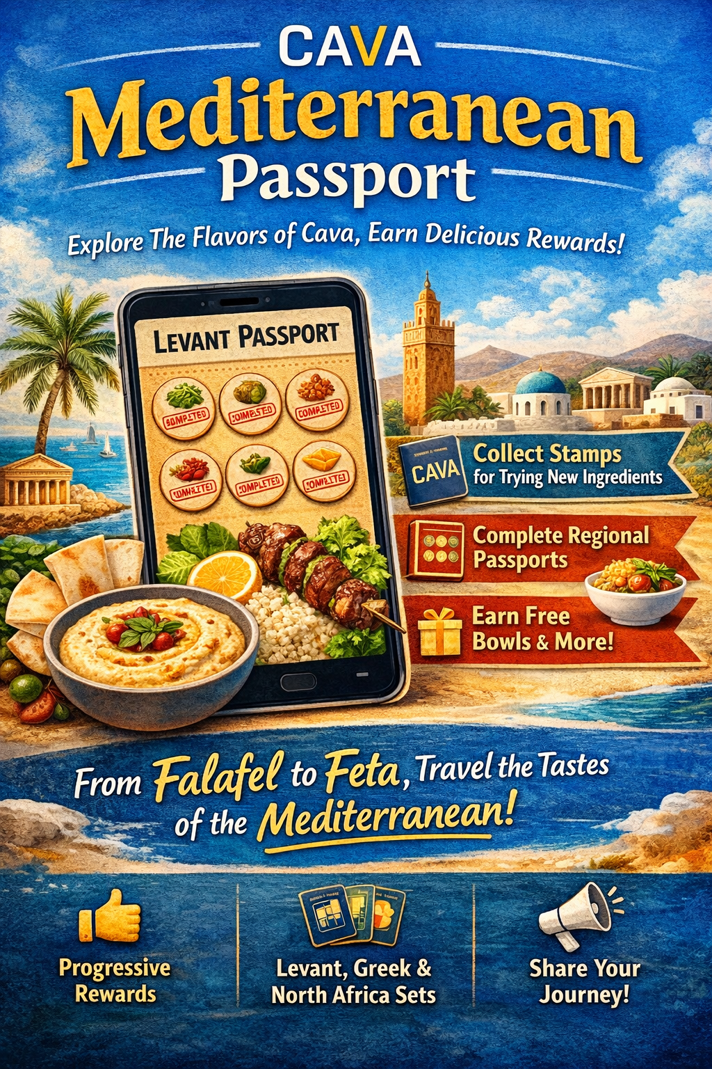
  A clear gap in a growing $200B market exists (and CAVA can take it)
CAVA’s Mediterranean first mover advantage enables standard setting and innovation
  CAVA’s expansion framework provides a solid foundation, but further capabilities are needed to support national scale
Industry scaling lessons highlight the importance of operational discipline, supply chain readiness, and clustered expansion
EXECUTIVE SUMMARY
CAVA must implement the Harrisa Strategy to reach their existing 1000+ store goal by 2031 with better operating margins
[Insert main value propositions that you bring to the table, e.g. experience with similar issues]
[Insert main value propositions]
…
The Harissa Strategy
  Market & Customer
  Capabilities
  Current Strategy
  Comp. Analysis
  1
  Production Facility Expansion
  1
  2
  3
  4
  A Mediterranean fast casual gap in a growing $200B market exists, and CAVA can become its’ national champion
  CAVA’s hybrid vertically integrated business model supports mediterranean authenticity at its current scale
  CAVA’s expansion framework provides a strong foundation, but additional capabilities are needed to support national scale
  Industry scaling lessons highlight the importance of operational discipline, supply chain readiness, and clustered expansion
  2
  CAVA University
  (Employee Education)
  3
  CAVA Passport
  (Consumer Education)
[Insert main value propositions that you bring to the table, e.g. experience with similar issues]
[Insert main value propositions]
…
Harissa Strategy Outcomes:
$89M NPV, 33% IRR
The Harissa Strategy is executable over 5-years with minimal risk
Key Project KPIs: Marginal units, SSS, Loyalty program members, Employee turnover
Key store level KPIs: Store P&L, Labor Cost, Restaurant Cashflow
Internal analysis
Central Production & Training Academy
[Insert main value propositions that you bring to the table, e.g. experience with similar issues]
[Insert main value propositions]
…
Notes:
Conor

Slide 3

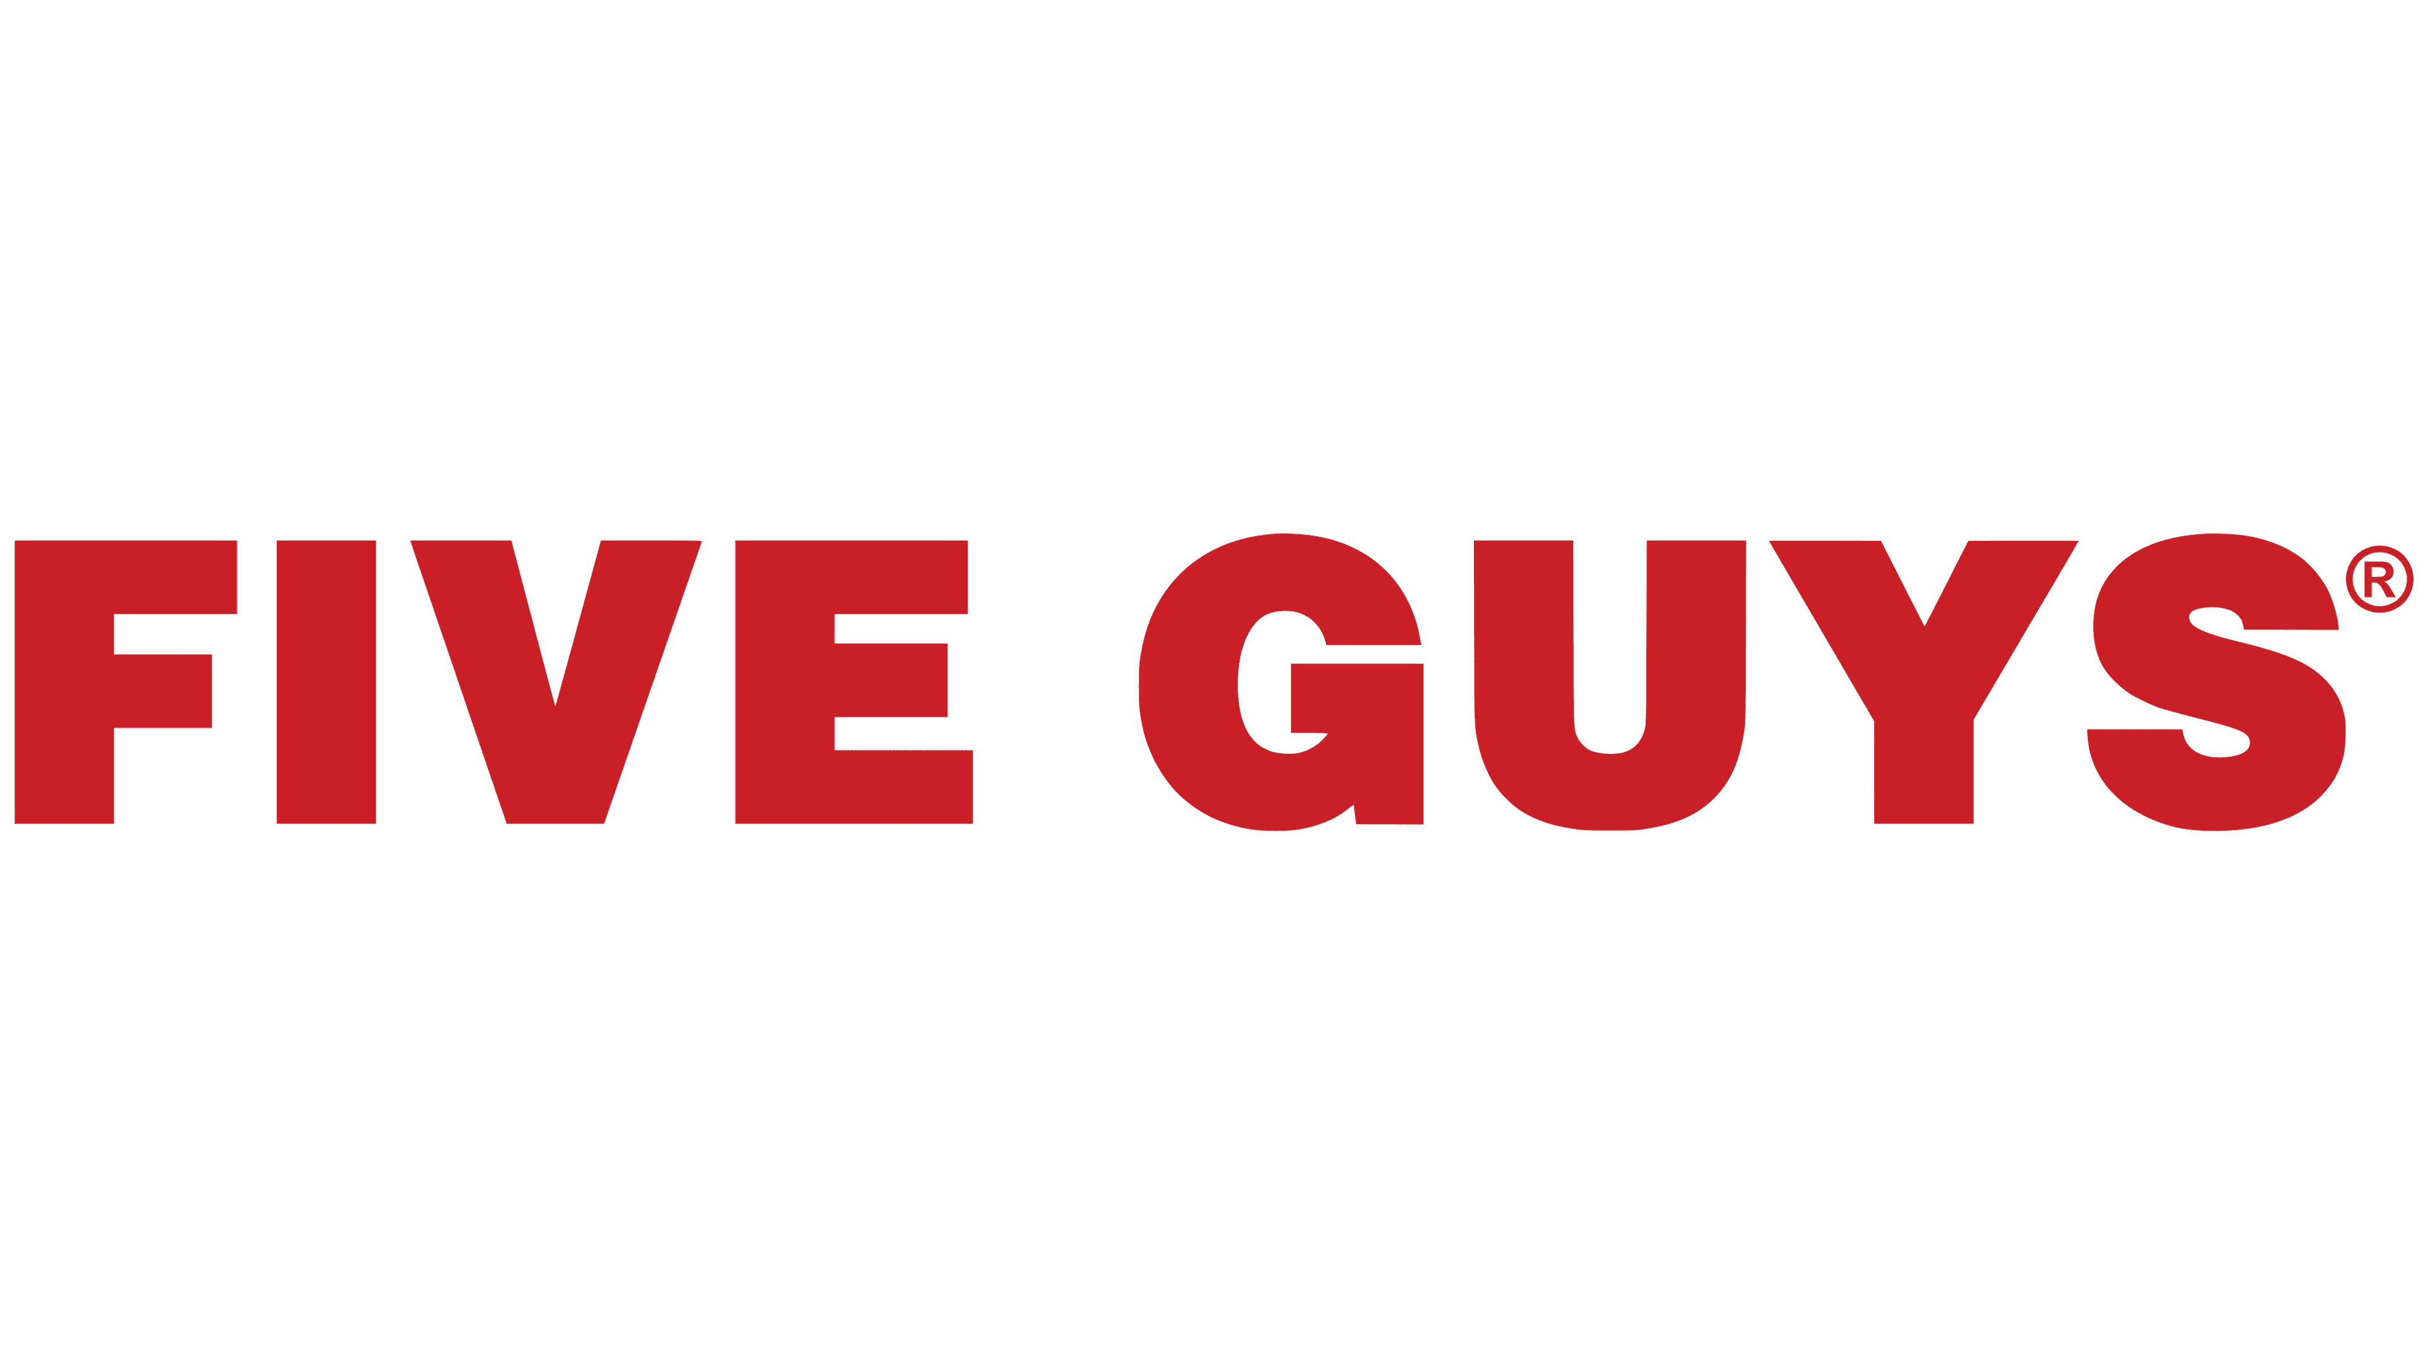
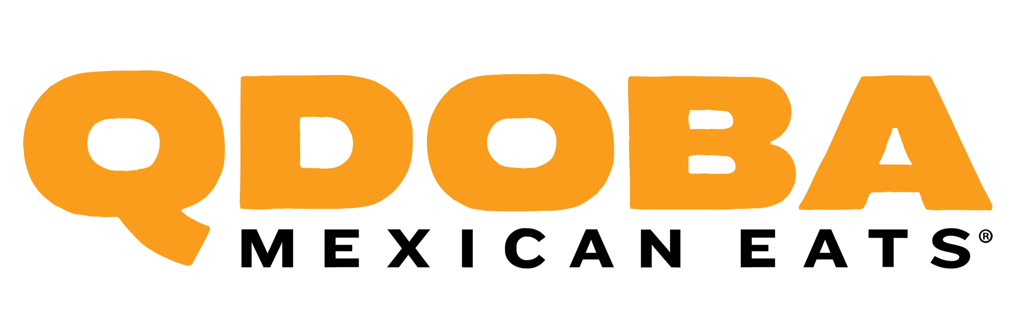

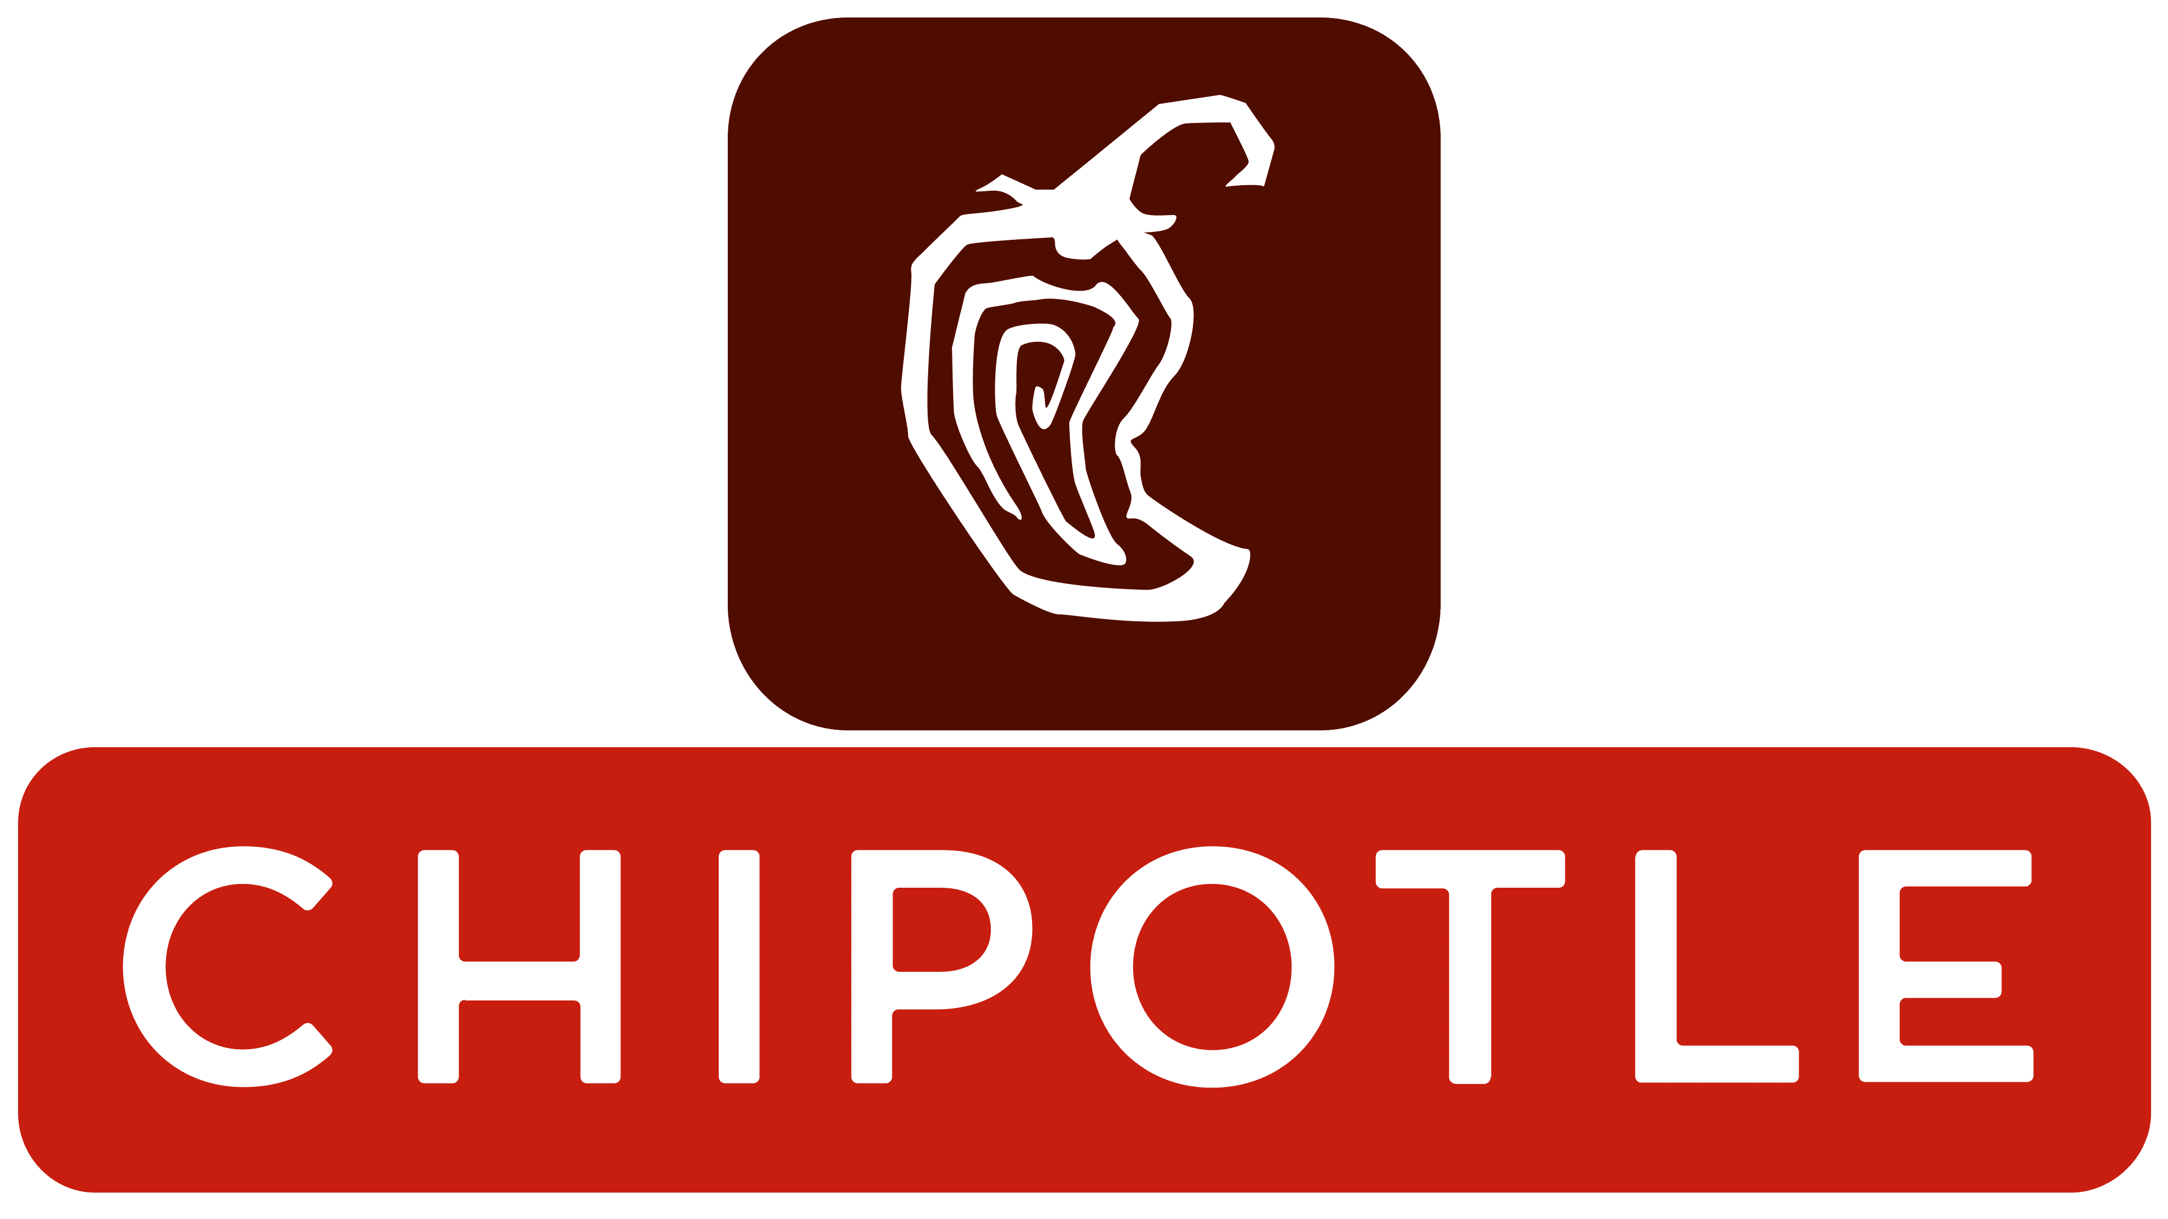


MARKET & CONSUMER ANALYSIS
A Mediterranean fast casual gap in a growing $200B market exists, and CAVA can become its’ national champion
Fast Casual Market Size (USD Billions)
Mediterranean Consumer Preferences
+7% CAGR
Mediterranean diet ranked #1 best diet rankings for 7 consecutive years (US News)
Preference
CAVA
Authenticity
Started with Greek immigrants
‘21
‘22
‘23
‘24
‘25
‘26
‘27
’28
‘29
‘30
‘31
‘32
‘33
Customization
50+ order combinations
Fast Casual Segments with National Chains
Only 19% price increase since 2019
Pricing
Mexican/Tex-Mex
Health-focused
Better Burger
Mediterranean
CAVA’s Core Customer
Mid Atlantic
18-35
College
65-130K
Metro
Mediterranean has no national champion. CAVA is only regional.
Location
Age
Education
Income
Area
Internal analysis, Straits Research 2025, Company Branding, US News 2025

Slide 4

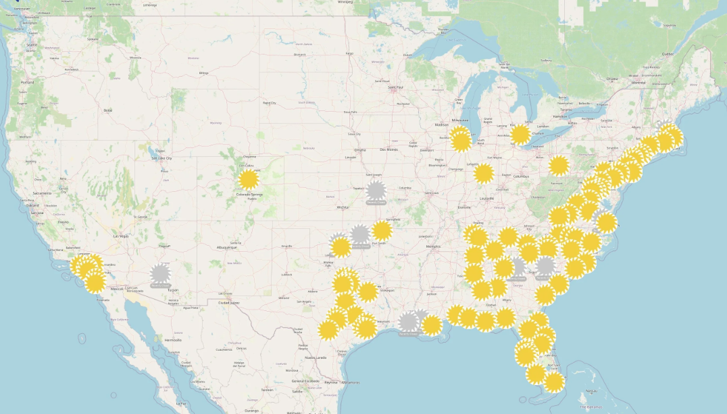
CAVA’s hybrid vertically integrated business model supports mediterranean authenticity at its current scale
The further a store is away, the higher risk of freshness deterioration
CAVA’s brand storytelling excellence
COMPANY CAPABILITIES
CAVA’s hybrid vertically integrated business model supports mediterranean authenticity at its current scale
Comparing Mid-Atlantic location to Texas—Distance correlated to store performance
Impact of Quality Degradation in Locations Distant from Production Hub
Driver | Year 1 | Year 2 | Year 3 | Year 4 | Year 5
Quality Retention Δ | -1.5% | -2.0% | -2.5% | -3.0% | -3.5%
Repeat Visit Rate Δ | -1.2% | -1.8% | -2.1% | -2.4% | -2.8%
SSS Drag from Quality Issues | -0.3% | -0.7% | -1.2% | -1.8% | -2.4%
Business Model
Centralized Production
CAVA delivers customizable, hospitality-driven bowls through fully company-owned locations, using a build-to-suit model with data-driven site selection and vertical integration across production and sourcing
The further a store is away, the higher risk of freshness deterioration
Risk Mitigation
Opening a production facility with centralized management training functions
Current facility cannot maintain projected 20% YoY growth
“Definitely ask what the ingredients are, though, it doesn’t make sense at all…but, however you choose, it’s never a miss.”
—Customer
CAVA’s D.C. Operations Center In Contrast To Stores
3
2
Bowl Preparation
Risks
Leased facilities and partner-supported distribution allow CAVA to expand capacity and market reach without taking on excessive fixed-cost infrastructure
CAVA Core Values
Driver
Fresh Ingredient Sourcing
Ops. Center
Distribution
Expanded production infrastructure is projected to support at least 700+ restaurants, giving CAVA credible near-term runway for continued store growth
Heart
Health
Humanity
Employees
Proprietary Production
Internal Analysis, CAVA Group Inc. Form 10-K, xMap
Raw Materials
Strength: Values
Constraint: Customer Education
CAVA can act differently from competitors because of first mover advantage which enables standard setting & innovation
Notes:
Cold-chain distributors
Ingredient and packaging suppliers
Non-core production partners
Technology vendors
Delivery platform partners
—
CAVA does not publicly identify most distribution partners by name; our recommendation refers to partnership categories aligned with its disclosed use of third-party suppliers and a limited number of distribution partners.
--
n markets where there is a clean slate and mediterrenanean first mover advantage, you will act differently than when you are second or third
”Definitely ask what the ingredients are though, it doesn’t make sense at all—but however you choose, it’s never a miss.” —Customer interview March 2026.
Cava business model postionst them well in the market bas 1st mover in med fast casual
Business overview
Scaeld wth built to suit
Cava committed to funding their growth with cash fully owning their stores with the Build to suit model and has control over the prodcution of their specialty dips and spreads which is the key driver of flavor that keeps the consumer coming back
Cava has a robust system for ensuring that the optimal ammount of highly perishable ingredinets like cucumbers, tomatse, meat deliering daily to their stores and prepared in house
Cavas business model both from an operartional and people standpoint postuons them as a first mover in the med-fast cas market
Cava has funded fast growth with cashflow funded buidl to suit model and identifies the locations they expand to with a data-driven site seleciton and vertical integreation across prodcution and sorucing. cava dips and spreads as well as other key flavors are a key falvor driver and they are produced in prodcution facilities lcoatied in marylans. We identified that the core of what differentiates cava is heart, heath and humanty,
For instantce If a customer walks in having a bad day, Employees can hit a love button and the meal is free, some of the ingredietns are confusing and there are a lot of options which we confirmed with a custoemr we interviewed and he directly said --- employees are helpgul with explainin what things are when customers get confused and creates a welcoming environemtn for customers unfamilaiar with med food to keep coming back to try new things because the flavors are what win.
These core values have one thing in common and that’s people. We can say that cava does people well. This execlelence in med hpsitlatity is driven by employees and at scale its mportatnt that cava maintains strengrh in this capablity.
One of cavas values is health. From an operational perspective freshness can not be compromised for scale. As seen in the map cava is clealry concentraded in the mid atalnistc region for the west locations, and expansion throughout the rest of the nation poses a concern about supply chain standards. We analused that the firther away a store is, the higher the risk of fresness detoriroation is posted. Cava has yet to expand their production faciltieis and capabiltes at scale. Additionally at current scale cava is doing employees well but to double store count successully by 2031 underscores the imporatnat of not compromosing valyes for scale

Slide 5




Cava's expansion framework requires further capabilities to support national scale
CURRENT GROWTH STRATEGY
CAVA’s expansion framework provides a strong foundation, but additional capabilities are needed to support national scale
Team and Resources
Jeff Gaul – CDO
Leads efforts across Strategy, RE, dealmaking, facilities & maintenance and design
New restaurant openings funded via internal cash flow and free cash flow
4 Dealmakers : (Northeast, West, Midwest, South/Florida)
20+ person Design and Construction team
Cash : 300+MM
Special purpose operations, supply-chain and Tech team
Adjusted EBITDA: 100+MM
Interviewed on 3/4/2026
Current Expansion Methodology
1. Identify
Third party optimization model pin-points locations based on market trends and CAVA internal customer and store traffic data
2. Adapt
Local “deal-makers” mold the third-party model’s recommendations: 20-25 confirmed locations per dealmaker per year
3. Plan
Future targets are put into a 2-year execution pipeline during which various team collaborate to connect the stores to the ecosystem
Technology Spotlight
Internal AI - team; Developed internal LLM’s for strategy team use
State of the art site selection software
AI-enabled construction monitoring software at every site tracking safety issues and potential delays
Training
CAVA Academy program for top performing GMs
Most training through existing restaurants
Constraints
Misaligned People – “The Governing constraint”
Sustaining “Mediterranean Hospitality,” the core philosophy of CAVA, through scale is nearly impossible if training and brand education is rushed or flawed
Misaligned Operations
As the primary operational hub is in the D.C. area, westward expansion poses serious quality and timeliness risks regarding the firm’s new unit growth target
Internal Analysis, Expert Interview on 3/4/2026, FORM 10-K
Notes:
Conor

Slide 6
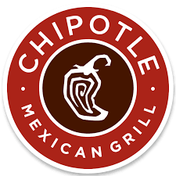




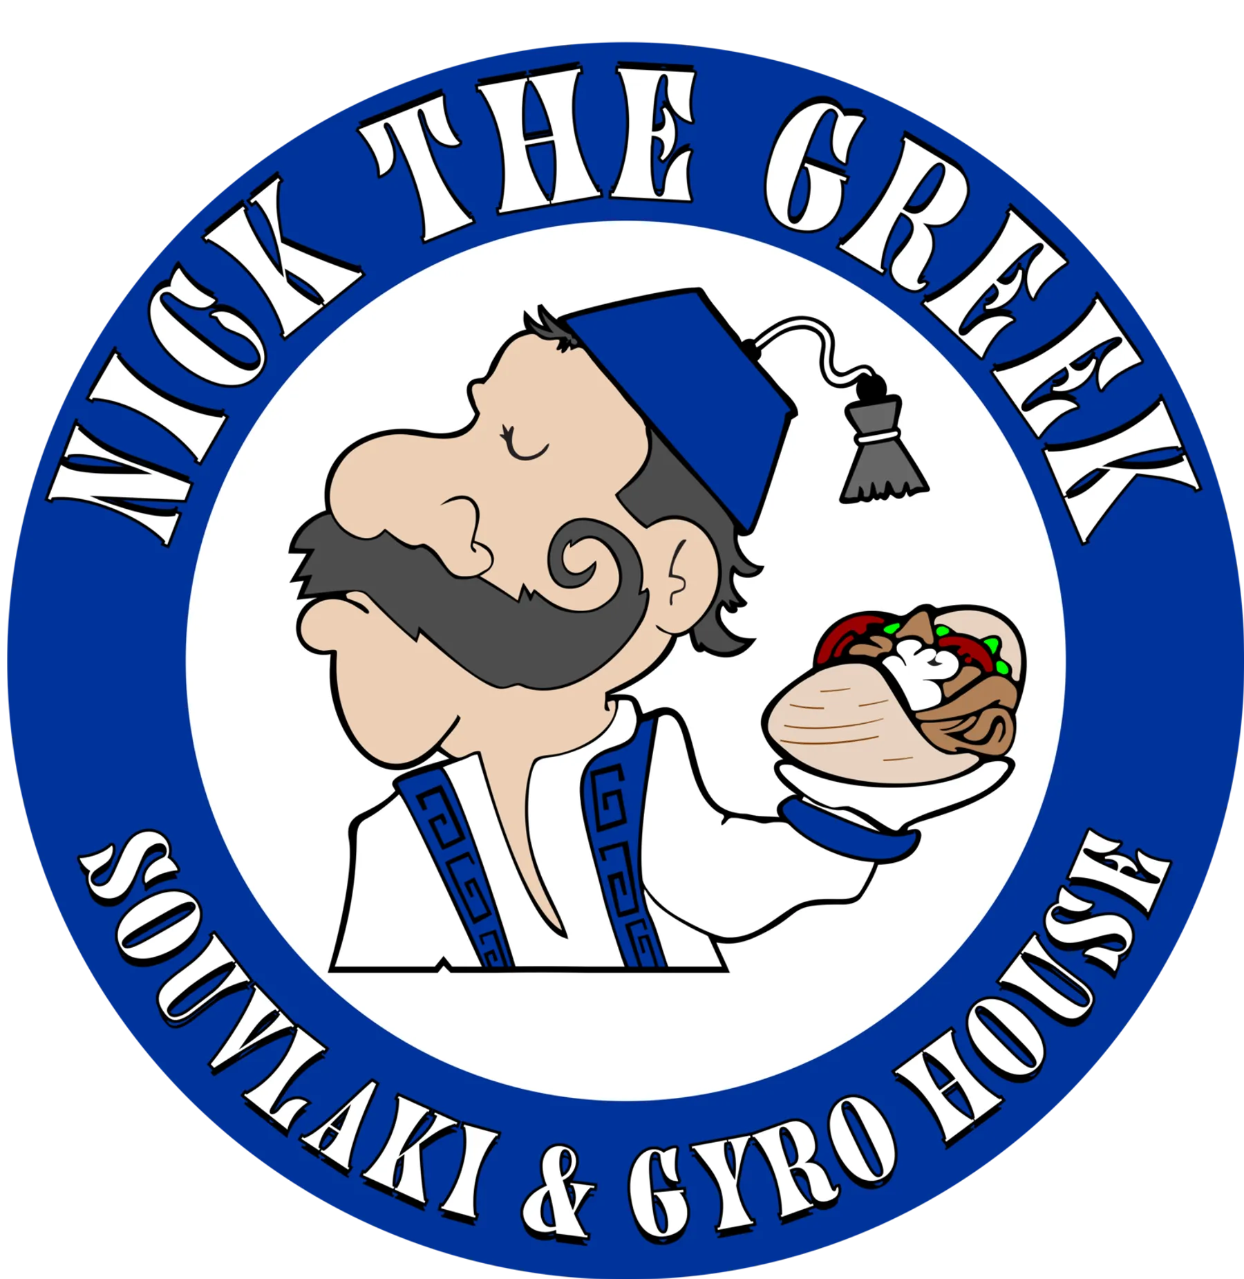
Chipotle as the growth benchmark
COMPETITOR ANALYSIS
Industry scaling lessons highlight the importance of operational discipline, supply chain readiness, and clustered expansion
National Competitor Analysis
Chipotle’s Growth = CAVA Benchmark
 | CAVA | Chipotle | Qdoba | Panda Express | Sweetgreen
Fast-Casual Specialty | Mediterranean | Mexican | Mexican | Asian | Health/Salad
Category | 2010 | 1993 | 1995 | 1983 | 2007
Stores | 415 | 3,950 | 740 | 2,500 | 280
AVG Transaction Value | $15.60 | $17.05 | $12.50 | $11.00 | $16.50
Model | Company-owned | Company-owned | Franchised | Franchised | Company-owned
Threat to Cava | N/A | High | Low | Low | Medium
Its national scale was built on clustered expansion, menu simplicity, and operational standardization, driving strong unit economics across thousands of locations. Its failures, rooted in supply chain and quality control breakdowns, show that systems must scale before growth does.
=> These lessons highlight the importance of building a disciplined expansion system rather than simply accelerating store openings
Expert Interview Insights: (conducted on 3/5/2026)
Expert Interview Insights:
“The bottleneck when you scale to thousands of restaurants isn’t just logistics - it’s the people. You need thousands of trained leaders ready to run the next generation of restaurants.”
“The bottleneck when you scale to thousands of restaurants isn’t just logistics - it’s the people. You need thousands of trained leaders ready to run the next generation of restaurants.”
Stephen Piacentini, Chief Development Officer - Chipotle
Emerging Mediterranean Competition
Stephen Piacentini, Chief Development Officer - Chipotle
Mediterranean fast-casual competition is growing as brands such as Taziki’s (~100 locations), Nick the Greek (~80+), and Taim (~15–20) attempt to scale quickly through franchising.
However, franchising often creates challenges around consistency and operational control.
“As you grow, you can’t leave supply chain behind. Every new market has to work operationally for distribution and food supply. We found success opening three to four restaurants in a market at the same time to create synergy for distribution and leadership.”
Cheryl Heidorn, Director of Development - Chipotle
Cheryl Heidorn, Director of Development - Chipotle
Internal analysis, Company Profiles, Expert Interview on 3/5/2026
New Mediterranean competition

Slide 7
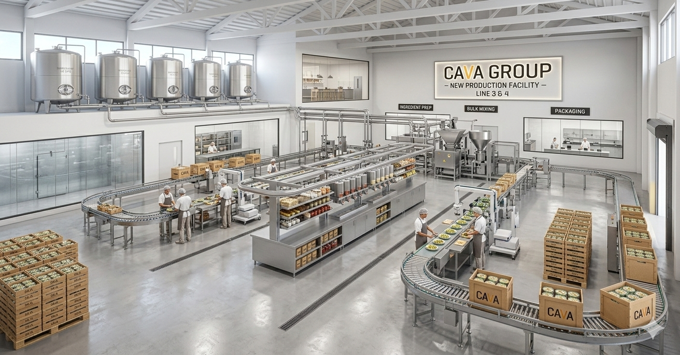
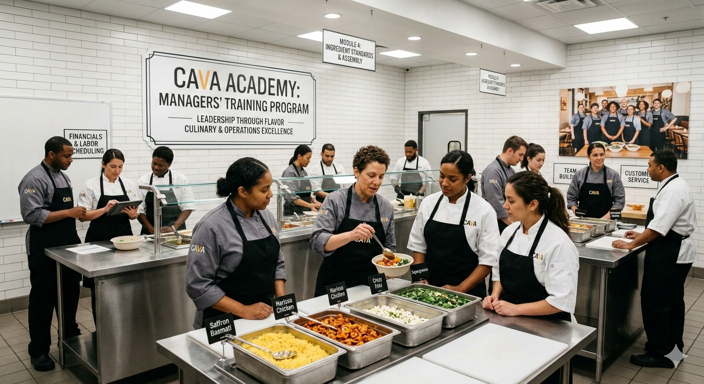

RECCOMENDATION
CAVA must execute a winning 3-part plan to develop employees, expand production, and gamify loyalty
The Harissa Strategy Breakdown
The Overlap
To support CAVA's expansion map, we recommend :
1
Production Expansion: new central* manufacturing & distribution Facility
2
Employee Development
Invest in a new Memphis, TN secondary production hub to support national expansion, unlock capacity beyond the 700-restaurant ceiling of the Maryland hub, and improve new unit margins at scale.
Innovation
Scale
WIN
3
1
CAVA University: centralized training facility to prepare tomorrow’s employees*
Loyalty Gamification
Production Expansion
2
Automation
Create a centralized leadership development program to train future managers, ensuring a scalable pipeline of
Operating Profit Upside (USD M.)**
“game-ready” leaders while improving consistency, reducing turnover costs, and enabling faster restaurant openings in new markets.
CAVA Passport: an educational program to strengthen CAVA’s digital and loyalty strategy
3
A digital 'Flavor Passport' gamifies menu exploration, progressively educating customers on CAVA's diverse offerings. Deeper menu familiarity drives repeat visits, sustaining SSS growth and lifting new unit AUV.
Functional Prototype of CAVA passport
Internal analysis; *Indicates same location ; **Full Revenue model available in the handout
Central Production & Training Academy
Notes:
Conor

Slide 8
NEXT STEPS
The Harissa Strategy is executable over 5-years with minimal risk
Key Activities | Year 1 |  |  |  | Year 2 |  |  |  | Year 3 |  |  |  | Year 4 |  |  |  | Year 5
Production Expansion (Memphis)
Capital Allocation & Permitting
Construction & Supplier Onboarding
Operational Ramp-up & Integration
CAVA University
Development
National Training Rollout
CAVA Passport
Platform Development
Pilot Market Launch
National Rollout
Primary yellow
Permitting
Construction
Operational Ramp-up & Distribution Integration
Curriculum Dev.
Secondary green
National Training Rollout
Platform Dev.
Pilot Market Launch
Pilot Market Launch
Secondary beige
National Rollout
Risk & Mitigations
Key Performance Indicators
Primary grey
 | 3 | 2
 | 1
Risk
Mitigation
Harissa Strategy KPIs
General Store KPIs
1. Capital discipline risk
1. Phased cap. deployment
Marginal Units
Same-store sales growth
Digital sales mix
Stores per market cluster
Production capacity utilization
Restaurant P&L
Labor efficiency
Rent ratio
ROI / Cashflow
Cannibalization
Severity
2. Manager capability gaps
2. Structured training
3. Brand quality dilution
3. Controlled growth pace
Probability
Internal Analysis, ENR Midwest
[Risk]
 | X
Severity
Probability
Notes:
There are 3 key risks about our rec we need to consider
Capaibiloity to open new stores because the p
By rmeoving bottleneck to growth cava capabltieis to increase unit cagr to 15-
rocess for training will be more efficient
The benchmark for our customer education witht eh passport will be same store sales growth expected to be in 3-5% range
Market entry efficiency
3-4 stores per market entry
Roi ensure proditbale and sustainable expansion
Success of memphis prodcution hub measured

Slide 10



EXECUTIVE SUMMARY
CAVA must implement the Harrisa Strategy to attain XXX% STAT by 2031
  What [Client] is looking for:
  [Insert description of main driver of issue e.g. Client has severe issues with profitability levels]…
…[Insert description of main need e.g. resulting in need to streamline costs]…
…[Insert description of added need or benefit e.g. with a focus on fast impact and cross-organizational implementation]
  What we bring:
[Insert main value propositions that you bring to the table, e.g. experience with similar issues]
[Insert main value propositions]
…
[Insert main value propositions that you bring to the table, e.g. experience with similar issues]
[Insert main value propositions]
…
[Insert main value propositions that you bring to the table, e.g. experience with similar issues]
[Insert main value propositions]
…
Central Production & Training Academy
Notes:
Conor

Slide 11
What Matters for CAVA and it’s investors: how do we evaluate growth
Store Growth numbers: CAVA trades at a higher multiple compared to peers driven by expected high store growth cadence while maintaining
Same Store Sales growth should stay consistent and significant to show maturing new restaurants and better economics
Sustainability + Consumer preferences + Calories per dollar + food safety : Maintain the healthy , fast casual brand and nutritional value + menu innovation –
Educate customers about the brand and mediterranean food more to support growth and potential auxiliary services
Maintain food quality, staff standards, timelines and margins despite regional differences – good supply chain execution (maybe see that in restaurant level profit margins)
Mediterranean food leadership

Slide 12
Recommendations
Primary
Pursue a conservative , clustered expansion : specific identified clusters to capture biggest opportunity while also reducing distribution costs per store and improve marketing efficiency
Better manufacturing presence by building new facilities and expanding supply chain to maintain throughput and speed ( capacity clock anticipating restaurants demand) which are key strategic pillars for CAVA + CAVA University later? + GS1 Traceability design ( new moat to complete FSQA ) + maybe supplier dev plans
Improve Loyalty and digital ecosystem : the CAVA Passport initiative. Rewards for trying different foods with different origins and invite to try new menu items etc – can track it online + new menu item customer participation option + integrate with loyalty program ; Sea Sand sun and community days
Secondary
CPG / retail expansion mainly for dips, spreads and dressings to continue pushing brand reach ( Laurel facility expansion supports that already )
Format diversification : digital kitchens, catering hubs etc ) and partnerships
M&A to enhance capability , maybe supply chain centered ?
International expansion preparation ( Best practices for that , for later stages)

Slide 13
Ideas considered but we are not doing or maybe for future
Franchising stores
Tech automation investments , tech enabled prep
CAVA should further internalize its supply chain to maximize scaling potential
Market—7% CAGR over 7 years expected for
Consumer—x% our consumer segment express value for authenticity
Capabilities—
  centralized production of proprietary items
Competitive analysis—Chipotle during this growth stage had fully internalized its operations

Slide 14
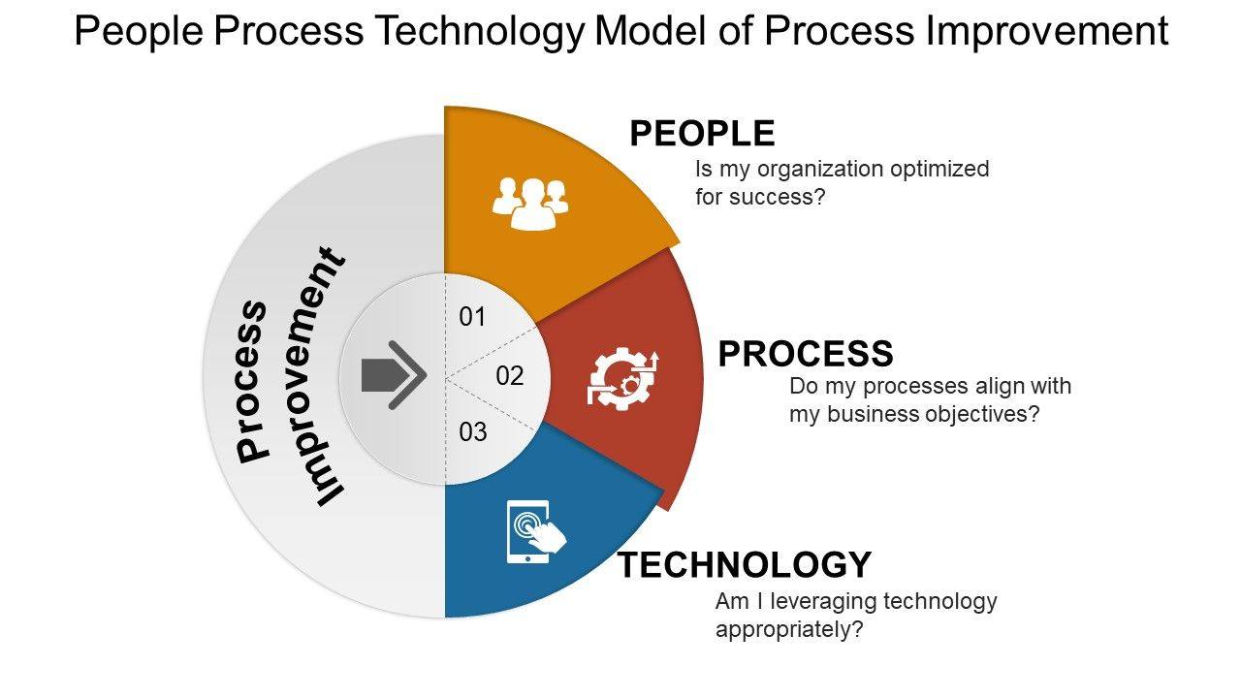
Recommendation

Slide 15
Passport
Playbook module: “Passport = Learn, Explore, Repeat” Make Passport more than points:
Mediterranean Trails: reward trying “origins” (Levant / Aegean / North Africa / etc.) and new ingredients; this drives education and menu discovery.
New-market onboarding journeys: when CAVA enters a new market, the app triggers a 30-day journey (3 visits, guided exploration, small rewards) tied to Community Days.
Shift from 3P to first-party: create Passport benefits that work best with pickup (priority pickup windows, exclusive bundles, catering perks), reducing dependency on marketplaces which CAVA lists as a ris

Slide 16
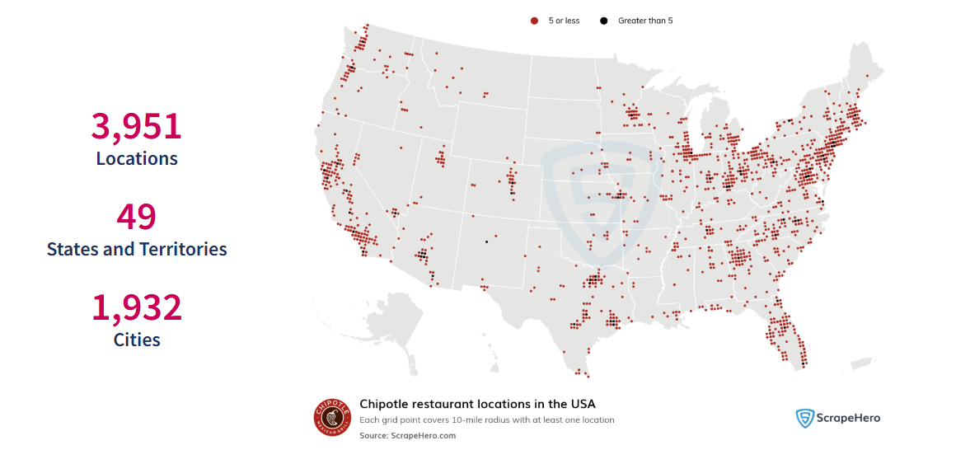
Chipotle as the growth Benchmark
Chipotle successfully scaled from a regional concept to 4,000+ restaurants while maintaining company ownership and operational consistency
The brand demonstrated how clustered expansion and disciplined real estate strategy enable efficient market entry
Chipotle built operational infrastructure (supply chain, training systems, and standardized store formats) that allowed rapid national scaling
The company sustained strong unit economics and throughput, making expansion financially self-reinforcing

Slide 17

CAVA University
Program Details
Other Examples

Slide 18
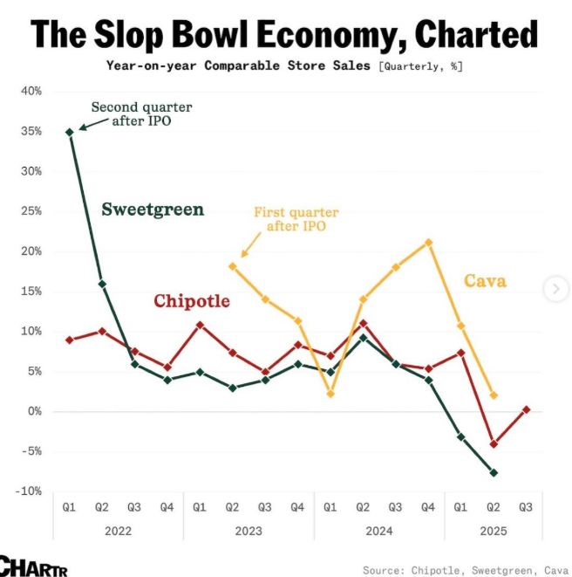
Cava should scale regional expansion while ...
Market insight- further market penetration in midwest and expanison to states in the west
Customer insight-
Competitive landscape insight- Keeping 100 calories/dollar, average transaction value vs. Chipotle
Company capabilities- Proven ability to maintain restaurant and commercial growth through vertical integration of manufacturing
Austin – South Congress
Seattle – Capitol Hill
Miami – Brickell
LA – Silver Lake / Santa Monica

Slide 19
CURRENT GROWTH STRATEGY
CAVA’s current growth plan proses human capital and operational risk
[Context of the client as it relates to the issue at hand]
Current Methodology
1. Identify
Third party optimization model pin-points locations based on internal data
2. Adapt
Local “deal-makers” mold the third party model’s recommendations
3. Plan
Future targets are put into a 2-year execution pipeline
Complications
Misaligned People
Sustaining “Mediterranean Hospitality,” the core philosophy of CAVA, through scale is nearly impossible if training is rushed or flawed
Misaligned Operations
As the primary operational hub is located in the D.C. area, westward expansion poses serious quality and timeliness risks
Key Question
[Goal of the client with important considerations]
Notes:
Conor

Slide 20
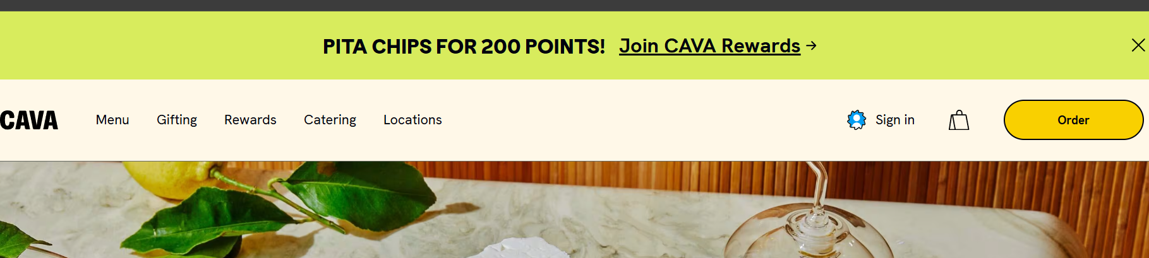
FORMATTING & STYLE GUIDE
Claim header
Primary Box
Work Area
Primary yellow
Primary grey
SLIDE SUBTITLE, CALIBRI 12, PRIMARY BLUE, UPPERCASE
Slide title, Calibri 24, secondary blue
Body text, Calibri 16, black
Secondary green
Secondary beige
Emphasis text, Calibri 16, secondary blue
Secondary Box
minor text, Calibri 12, black
White
Take-away box
Why construction and skilled trades workers?

Slide 21
FORMATTING & STYLE GUIDE
Line dividers to be used to ensure proper spacing between elements
Work Area

Slide 22
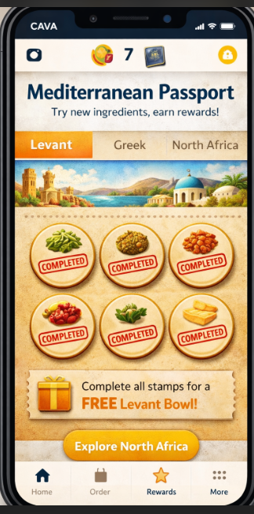
RECCOMENDATION
CAVA must create CAVA XXX to
Identify Good Real Estate
WHY
HOW
Increase Operational Support
WHY
HOW
Existing Hub
New Hubs
1
2
3
Verona (East)
Memphis (Central)
LA (West)
Educate Consumers on CAVA
WHY
HOW
Notes:
Conor

Slide 23
RECCOMENDATION
CAVA must address identification, support, and brand education to grow
2. Aid locations with production support
Phase 1
Memphis Hub
D.C.
Hub
Notes:
Conor

Slide 24
COMPANY CAPABILITIES
1
Centralized Proprietary Production
2
3
Asset-light Operating Model
Capacity for Growth
CAVA vertically integrates proprietary items for restaurants and CPG, ensuring product consistency and quality control
Leased facilities and partner-supported distribution allow CAVA to expand capacity and market reach without taking on excessive fixed-cost infrastructure
Expanded production infrastructure is projected to support at least 700+ restaurants, giving CAVA credible near-term runway for continued store growth
 | Degree of Control
Strategic importance to scale |  | Low | High
 | Low | External review risk Landlord conditions | Menu Education Training
 | High | Distribution Last-mile delivery | Centralized Production Quality Assurance
Cava should internalize logistics planning and quality control while using strategic partners for distribution execution.
CASA Group Inc. Form 10-K, EDGAR, sec.gov
Notes:
Cold-chain distributors
Ingredient and packaging suppliers
Non-core production partners
Technology vendors
Delivery platform partners
—
CAVA does not publicly identify most distribution partners by name; our recommendation refers to partnership categories aligned with its disclosed use of third-party suppliers and a limited number of distribution partners.

Slide 25
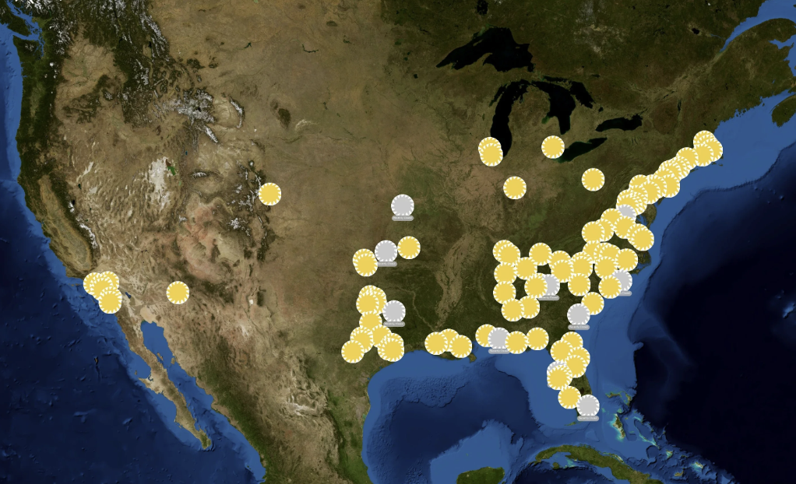
COMPANY CAPABILITIES
CAVA’s business model embraces “Mediterranean Hospitality”
1
Centralized Proprietary Production
2
3
Asset-light Operating Model
Capacity for Growth
CAVA vertically integrates proprietary items for restaurants and CPG, ensuring product consistency, quality control, and protection of brand-defining recipes
Leased facilities and partner-supported distribution allow CAVA to expand capacity and market reach without taking on excessive fixed-cost infrastructure
Expanded production infrastructure is projected to support at least 700+ restaurants, giving CAVA credible near-term runway for continued store growth
Comparing Mid-Atlantic location to Texas—Distance correlated to store performance
Impact of Quality Degradation in Locations Distant from Production Hub
Driver | Year 1 | Year 2 | Year 3 | Year 4 | Year 5
Quality Retention Δ | -1.5% | -2.0% | -2.5% | -3.0% | -3.5%
Repeat Visit Rate Δ | -1.2% | -1.8% | -2.1% | -2.4% | -2.8%
SSS Drag from Quality Issues | -0.3% | -0.7% | -1.2% | -1.8% | -2.4%
CASA Group Inc. Form 10-K, EDGAR, sec.gov
Notes:
Cold-chain distributors
Ingredient and packaging suppliers
Non-core production partners
Technology vendors
Delivery platform partners
—
CAVA does not publicly identify most distribution partners by name; our recommendation refers to partnership categories aligned with its disclosed use of third-party suppliers and a limited number of distribution partners.

Slide 26
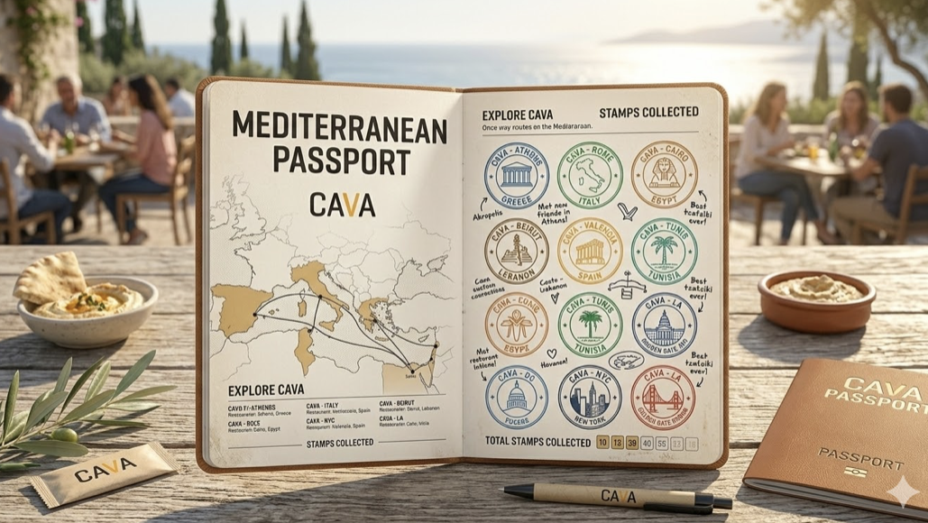
RECCOMENDATION
CAVA Hub will mitigate
CAVA Hub (Production & Training)
OUTCOMES
CAVA Passport (Consumer Education)
Mexican/Tex-Mex
Mexican/Tex-Mex
Mexican/Tex-Mex
CAVA Academy
Central Production & Training Academy
Notes:
Conor

Slide 27
MARKET & CONSUMER ANALYSIS
Mediterranean is the last unowned category in a growing $200B market
Consumers Love Mediterranean & Its Qualities
Mediterranean diet ranked #1 best diet rankings for 7 consecutive years (US News)
Calories/dollar Value
CAVA has this!
In-Store Experience
CAVA has this!
Authenticity & Freshness
CAVA has this!
Fast casual grows at 7% CAGR to $319B by 2033, driven by Millennial/Gen Z demand for health, transparency, and value. Cava's target customer (HHI $60K+, health-index high) where Mediterranean has zero incumbent. The category is large, the growth is structural, and the white space is Cava's to claim. – needs to be wokrshoped
Internal analysis, Straits Research 2025, US News

Slide 28
COMPETITOR ANALYSIS
Industry scaling lessons highlight the importance of operational discipline, supply chain readiness, and clustered expansion
Key competitors
Chipotle as the growth benchmark
 | Cava | Chipotle | Qdoba | Panda Express | Sweetgreen
Fast-Casual Specialty | Mediterranean | Mexican | Mexican | Asian | Health/Salad
Category | Item | Item | Item | Item | Item
Stores | 415 | 3,950 | Item | Item | Item
AVG Transaction Value | $15.60 | $17.05 | $12.50 | $11.00 | $16.50
Model | Company-owned | Company-owned | Franchised | Franchised | Company-owned
Threat to Cava | N/A | High | Low | Low | Medium
After analyzing the key success and failure stories in the space we believe Chipotle represents the clearest benchmark for scaling a fast-casual concept nationally at CAVA’s current stage. Its success came from pairing clustered market expansion, simple menu design, and operational standardization, allowing strong unit economics across thousands of locations. At the same time, early food safety and hiring failures highlighted how supply chain and quality control systems must scale ahead of growth.
=> These lessons highlight the importance of building a disciplined expansion system rather than simply accelerating store openings
Expert Interview Insights: (conducted on 3/5/2026)
New Mediterranean competition
“The bottleneck when you scale to thousands of restaurants isn’t just logistics - it’s the people. You need thousands of trained leaders ready to run the next generation of restaurants.”
Mediterranean fast-casual competition is growing as brands such as Taziki’s (~100 locations, franchised), Nick the Greek (~80+, franchised), and Taim (~15–20 locations) attempt to scale quickly through franchising.
However, franchising often creates challenges around consistency and operational control. In contrast, CAVA’s company-owned model, vertically integrated production, and first-mover advantage create a stronger operational moat and position it as the category leader.
Stephen Piacentini, Chief Development Officer - Chipotle
“As you grow, you can’t leave supply chain behind. Every new market has to work operationally for distribution and food supply. We found success opening three to four restaurants in a market at the same time to create synergy for distribution and leadership.”
Internal analysis,
Cheryl Heidorn, Director of Development - Chipotle

Slide 29
CAVA can act differently from competitors because of first mover advantage which enables standard setting & innovation
CAVA’s hybrid vertically integrated business model supports mediterranean authenticity
The further a store is away, the higher risk of freshness deterioration
COMPANY CAPABILITIES
CAVA’s hybrid vertically integrated business model supports mediterranean authenticity
Comparing Mid-Atlantic location to Texas—Distance correlated to store performance
Impact of Quality Degradation in Locations Distant from Production Hub
Driver | Year 1 | Year 2 | Year 3 | Year 4 | Year 5
Quality Retention Δ | -1.5% | -2.0% | -2.5% | -3.0% | -3.5%
Repeat Visit Rate Δ | -1.2% | -1.8% | -2.1% | -2.4% | -2.8%
SSS Drag from Quality Issues | -0.3% | -0.7% | -1.2% | -1.8% | -2.4%
Business Overview
Centralized Production
CAVA provides customizable bowls and a hospitality-driven experience supported by hybrid vertically integrated proprietary production and fresh ingredient sourcing. The company 100% owns and runs all locations with a build to suit model supported by data-driven sight selection and regional liaisons.
The further a store is away, the higher risk of freshness deterioration
Risk Mitigation
Opening a production facility with centralized management training functions
Current facility cannot maintain projected 20% YoY growth
Strength: Values
CAVA Core Values
Driver
CAVA’s D.C. Operations Center In Contrast To Stores
3
2
Bowl Preparation
Risks
Leased facilities and partner-supported distribution allow CAVA to expand capacity and market reach without taking on excessive fixed-cost infrastructure
Heart
Health
Humanity
Employees
Fresh Ingredient Sourcing
Ops. Center
Constraint: Customer Education
”Definitely ask what the ingredients are though, it doesn’t make sense at all—but however you choose, it’s never a miss.” —CAVA Customer
Distribution
Expanded production infrastructure is projected to support at least 700+ restaurants, giving CAVA credible near-term runway for continued store growth
Proprietary Production
Source
Raw Materials
Notes:
Cold-chain distributors
Ingredient and packaging suppliers
Non-core production partners
Technology vendors
Delivery platform partners
—
CAVA does not publicly identify most distribution partners by name; our recommendation refers to partnership categories aligned with its disclosed use of third-party suppliers and a limited number of distribution partners.
--
n markets where there is a clean slate and mediterrenanean first mover advantage, you will act differently than when you are second or third
”Definitely ask what the ingredients are though, it doesn’t make sense at all—but however you choose, it’s never a miss.” —Customer interview March 2026.

Slide 30
CAVA’s hybrid vertically integrated business model supports mediterranean authenticity
The further a store is away, the higher risk of freshness deterioration
COMPANY CAPABILITIES
CAVA’s hybrid vertically integrated business model supports mediterranean authenticity
Comparing Mid-Atlantic location to Texas—Distance correlated to store performance
CAVA Overview
Impact of Quality Degradation in Locations Distant from Production Hub
Driver | Year 1 | Year 2 | Year 3 | Year 4 | Year 5
Quality Retention Δ | -1.5% | -2.0% | -2.5% | -3.0% | -3.5%
Repeat Visit Rate Δ | -1.2% | -1.8% | -2.1% | -2.4% | -2.8%
SSS Drag from Quality Issues | -0.3% | -0.7% | -1.2% | -1.8% | -2.4%
CAVA provides customizable bowls and a hospitality-driven experience supported by hybrid vertically integrated proprietary production and fresh ingredient sourcing. The company 100% owns and runs all locations with a build to suit model supported by data-driven sight selection and regional liaisons.
Key Strength | CAVA Values
Key Constraint | Customer Education
Heart
3
”Definitely ask what the ingredients are though, it doesn’t make sense at all—but however you choose, it’s never a miss.” —CAVA Customer
2
Bowl Preparation
Risks
Health
Leased facilities and partner-supported distribution allow CAVA to expand capacity and market reach without taking on excessive fixed-cost infrastructure
CAVA’s D.C. Operations Center In Contrast To Stores
Fresh Ingredient Sourcing
Humanity
Ops. Center
Distribution
Expanded production infrastructure is projected to support at least 700+ restaurants, giving CAVA credible near-term runway for continued store growth
Proprietary Production
Source
Raw Materials
Centralized Production
CAVA Core Values
Driver
The further a store is away, the higher risk of freshness deterioration
Risk Mitigation
Opening a production facility with centralized management training functions
CAVA can act differently from competitors because of first mover advantage which enables standard setting & innovation
Current facility cannot maintain projected 20% YoY growth
Employees
Notes:
Cold-chain distributors
Ingredient and packaging suppliers
Non-core production partners
Technology vendors
Delivery platform partners
—
CAVA does not publicly identify most distribution partners by name; our recommendation refers to partnership categories aligned with its disclosed use of third-party suppliers and a limited number of distribution partners.
--
n markets where there is a clean slate and mediterrenanean first mover advantage, you will act differently than when you are second or third
”Definitely ask what the ingredients are though, it doesn’t make sense at all—but however you choose, it’s never a miss.” —Customer interview March 2026.

Slide 31
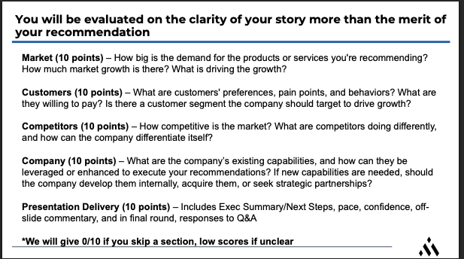
Cava should implement the Harissa Strategy to attain 25%+ CAGR in 5 years.
Clear national gap in the med market and Cava can take it
- CAGR
- Cava has first mover advantage in fast casual Mediterranean
Existing customer base is strong
Willing to pay
Calories per dollar
Cava shows cracks in core values at scale
Throughput analysis shows why stores might close
Training is hard attrition 25% chipotle managers
Cava is great at flavor by emphasizing freshness and menu versality
- Facility capacity and what they can handle at scale with p
- Quote
Next steps --- make this 3-5 words
Digital passport
Kava university + production facility

