Slide 1
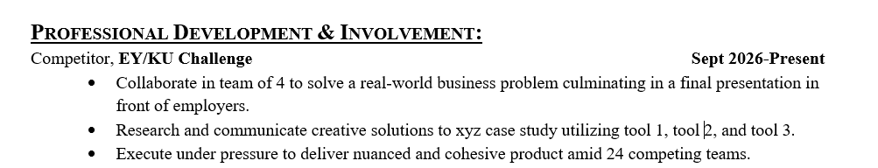
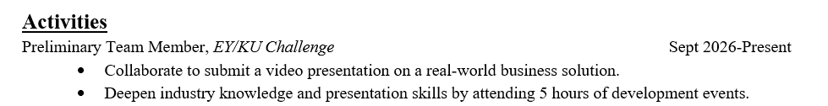
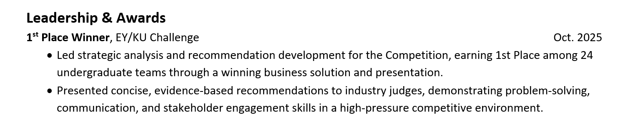
Case Competitions & Resumes
Business Career Services & Professionalism

Slide 2
Case Competitions & Interviews
Business Career Services & Professionalism
Tell me about a time when…
You worked in a team
You showed initiative
You were handed a task and weren’t sure how to start
You had to present your ideas persuasively
You had a tight timeline to meet a goal
You felt challenged or overwhelmed
You had to compromise or collaborate on an idea
You worked on a large project

Slide 3

Business Career Services & Professionalism
Business Career Services & Professionalism
Make an appointment or drop in (Mon & Thurs 12:30 – 4)
Refine a resume
Make a networking plan
Practice interviewing
Discuss how to start a portfolio
Learn about recruiters/employers
Discuss Suitable points and professionalism requirements
Find a mentor
Be sure to select ‘business’ as the location

