Slide 1
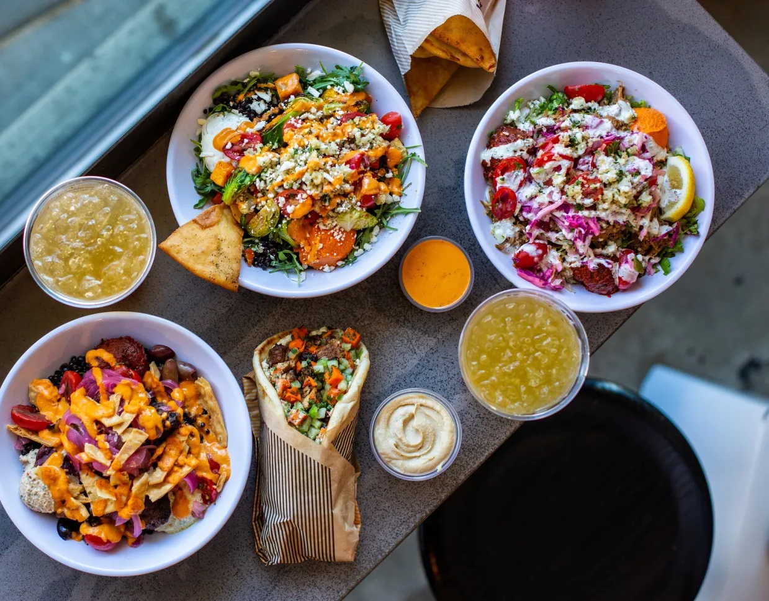

Strategic Acquisition of Luna Grill
Team 04
Trey Cunneen | Collin Ford | Elise Lewis | John Otto
KU School of Business National Case Competition

Slide 2
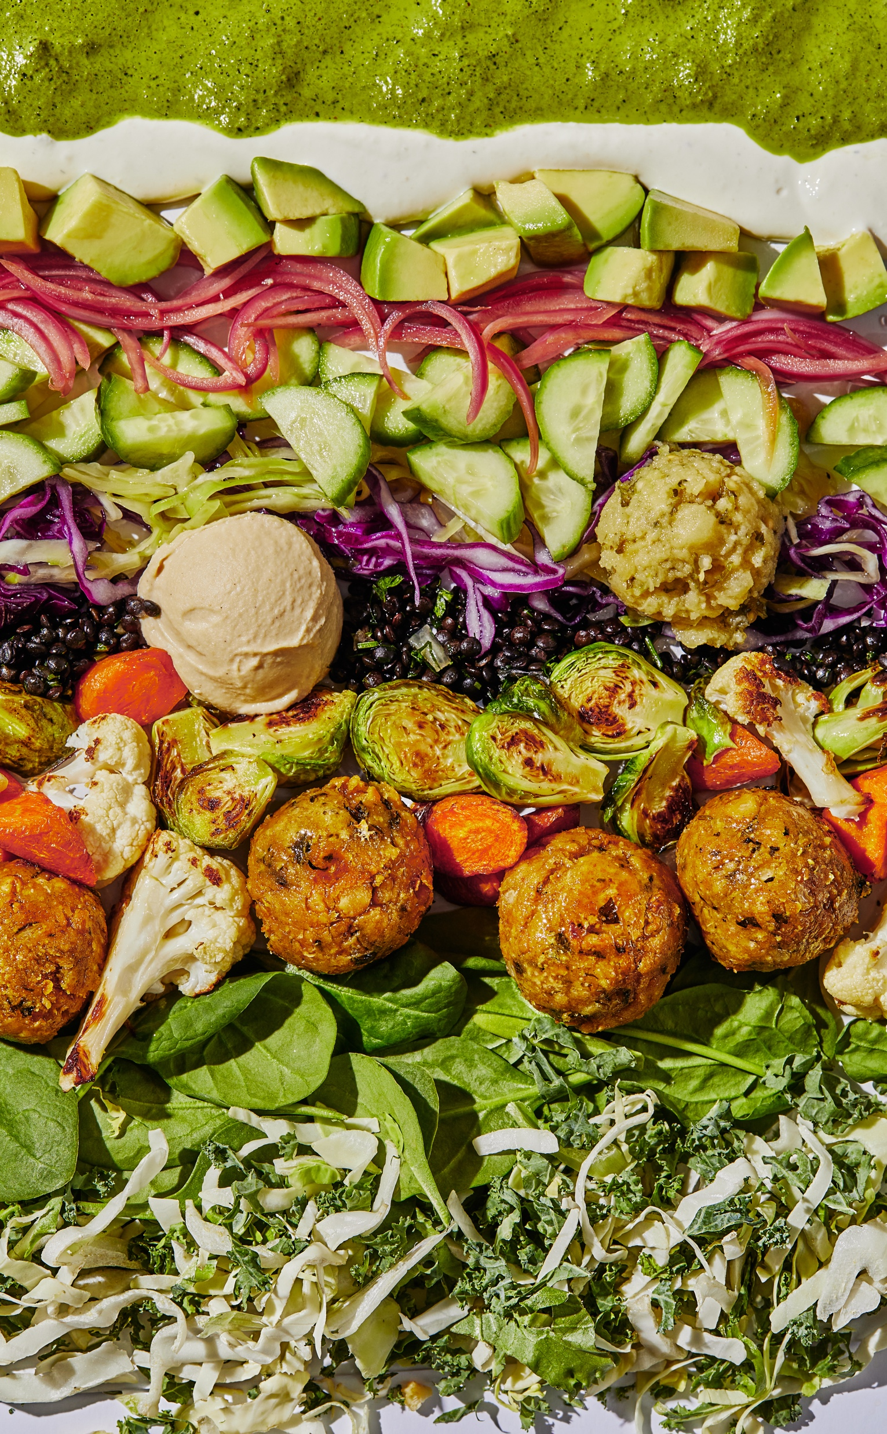
x
Acquire Luna Grill to unlock a $243M speed-to-market arbitrage
$170 – 225M
100% cash reserves
>100% principal
est. purchase price
funding source
5-year payback
1
Bypass construction bottlenecks by acquiring 50 turnkey Sunbelt locations
Captures a $243M Revenue Premium by securing Day-1 operational assets
Market
2
Leverage 95% demographic overlap to eliminate Western market education costs
Achieves an 80% CAC Reduction via surgical digital loyalty migration
Consumer
3
Deploy 16% pricing moat to capture consumers trading down from casual dining
Projects a 46.7% AUV lift for acquired units via CAVA’s growth engine
Competitive
4
Inherit Western supply hubs to eliminate 2,500-mile cold-chain logistics risk
De-risks the next 100+ organic stores through a vetted regional vendor network
Operations

Slide 3
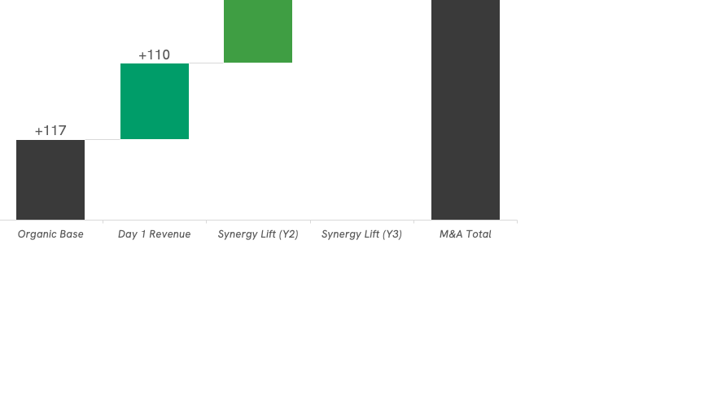
Acquire 50 turnkey Sunbelt locations to bypass development bottlenecks
Cumulative Revenue: Organic vs. M&A | Years 1-3
M&A unlocks immediate capital, bypassing the standard 18–24-month greenfield permitting and construction pipelines.
($M)
CAVA captures a $243M speed-to-market premium by deploying capital into operational Luna Grill assets rather than trapping it in greenfield construction.
+$243M
KU School of Business National Case Competition

Slide 4
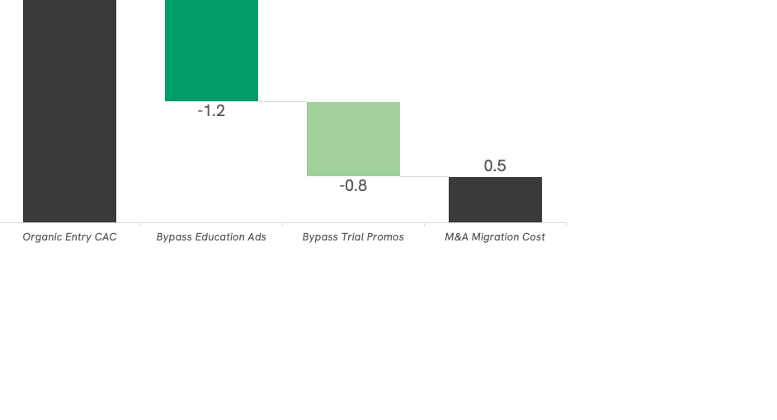
"CAVA saves $2.0M in marketing burn by converting Luna’s established Mediterranean fanbase rather than funding 24 months of regional brand education."
Migrate pre-educated Western diners to bypass costly market education
Customer Acquisition Cost (CAC) Efficiency: Organic Entry vs. M&A Migration
 | CAVA | Luna Grill
Age | 18-35 | 25-44
Income | $92K | $80K-$110k
Values | Non-GMO & Fresh | Eat Real Certified
Mobile | CAVA App | Club Luna App
Menu | Bowls, Falafel | Kebabs, Bowls
CAVA saves $2.0M in marketing burn by converting Luna’s established Mediterranean fanbase rather than funding 24 months of regional brand education.
-$2M
KU School of Business National Case Competition

Slide 5
Deploy Cava’s pricing moat to expand regional margins
Strategic Arbitrage: Pricing Discipline vs. Sales Momentum
CAVA’s 16% pricing moat captures trade-down volume from competitors who have increased prices by 30-40% since 2019
1. Value Arbitrage:
CAVA’s 16% price discipline vs. 30%+ industry hikes induces trial in new markets.
2. Trade-Down Capture:
Competitive pricing attracts consumers trading down from casual dining.
3. Unit Optimization:
Rebranding Luna Grill projects a 46.7% AUV lift over 36 months via CAVA’s growth engine.

Slide 6
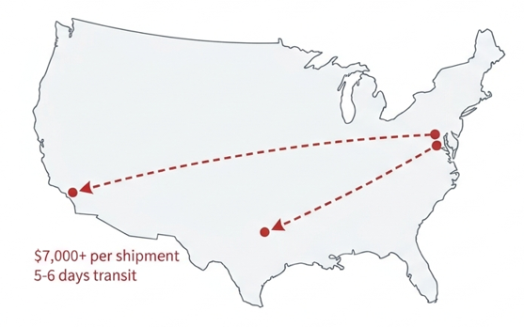
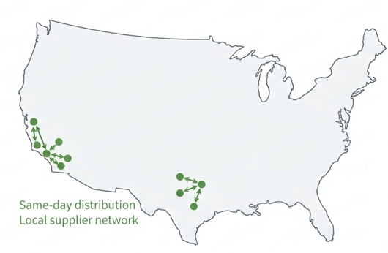
Integrate established Western supply hubs to safely scale operations
Without Acquisition
With Acquisition
Supply Chain Gap
What CAVA Inherits
$7 - $8k per truckload from East Coast
12 - 24 months to vet Western farmers
$5M Capex for new Western commissary
Local same-day distribution through regional hubs
20 years of Mediterranean supplier relationships
Convertible kitchen space for regional production
KU School of Business National Case Competition

Slide 7
Execute the Luna Grill acquisition to secure Sunbelt market leadership
1
100% Cash Acquisition
Deploy $212M cash reserves to maintain a debt-free capital structure
Rebranding these units into the “CAVA Engine” projects a 46.7% AUV lift and full principal payback within 36 months
2
Competitive Dominance
Secure a 20-year Western supply network on Day 1, de-risking the next 100 organic store openings
Realize the $243M speed-to-market premium by operationalizing assets immediately rather than waiting 20 months
3
Deploy 16% pricing moat to capture consumers trading down from casual dining
Projects a 46.7% AUV lift for acquired units via CAVA’s growth engine
Priority
-
Month 1: Sign the LOI and finalize the transition of regional supply hubs
-
Months 2-5: Execute the surgical re-skin of 50 units and deploy the 16% pricing moat
-
Month 6+: Launch targeted Sunbelt loyalty migration, aiming for 100k redemptions in year one

Slide 8

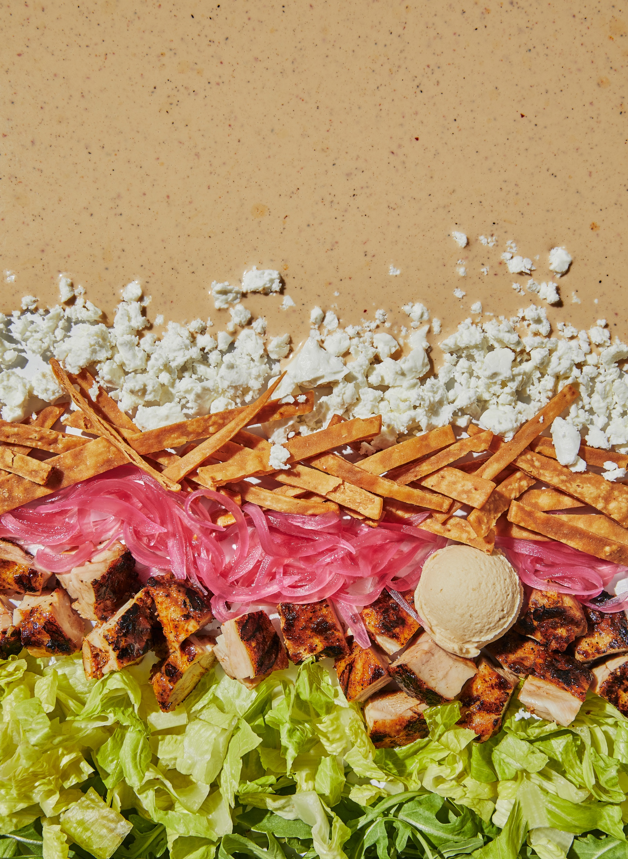
Appendix

Slide 9
Customer Analysis
  $83.20 CAC figure: fast-casual industry average
  500K customer estimate: $75M Luna revenue ÷ $150 estimated annual spend per active customer
  $700K migration cost: $5 credit × 140K high-frequency users (top ~28% of base, consistent with loyalty program engagement norms)
Leverage CAVA’s liquid balance sheet to buy 24 months of market velocity
The estimated enterprise value for Luna Grill is anchored in a regional growth multiplier, reflecting the high value of turnkey real estate in the CA/TX "Sunbelt" corridor.
100% CASH
Zero-Cost Capital: CAVA currently holds $332.4M in cash earning ~4-5% interest. With high interest rates (SOFR + 2.50%), taking on debt would create a significant interest expense drag of $10M–$15M annually.
Balance Sheet Virginity: CAVA is one of the few high-growth brands with zero long-term debt. Maintaining this "pristine" structure allows us to keep our $98.3M Credit Facility entirely for future organic "Mediterranean Engine" growth.
Category | Assumption | Rationale
Store Count | 50 Units | Historical average unit volume for regional Mediterranean peers
Unit AUV (Est.) | $1.70M | Pre-synergy revenue baseline for regional Mediterranean peers
Target Revenue | $85.0M | Calculated as (50 units * 1.70M AUV)
Applied Multiple | 2.0x – 3.0x | Industry standard for CA M&A with quick-serve restaurant assets
Enterprise Value | $170M – 225M | Implied Enterprise Value (EV) for the acquisition
Funding Strategy | 100% cash | Utilization of CAVA’s $332.4M cash reserves (2025 10-K)
I. REVENUE CAPTURE
Logic: Organic expansion in CA/TX faces an 18–24 month "permitting and construction waiting room."
Math: By acquiring 50 units, CAVA captures a $243M incremental revenue delta over 36 months that would be lost to construction delays.
Result: The revenue "premium" pays for the acquisition principal within the first three years.
II. MARGIN PROTECTION
Logic: CAVA’s East Coast supply chain is strained at 2,500 miles. Organic expansion would require a $5M+ investment in a new Western commissary.
Math: Inheriting Luna’s established Western supply hubs and 20-year vendor network provides Day-1 security.
Result: Eliminates $5M in immediate Capex and significantly reduces logistical "middle-mile" costs.
III. CAC EFFICIENCY
Logic: Entering a cold market requires heavy brand-education spending.
Math: With a 95% demographic overlap, CAVA converts a "warm" Luna customer for a $5.00 loyalty credit vs. the $25.00+ organic cost of ads and discounts.
Result: An 80% reduction in Customer Acquisition Cost (CAC), protecting regional EBITDA from day one.

Slide 10
M&A vs. organic growth analysis
Variable | Value | Rationale
Acquisition Target | 50 Units | Historical average unit volume for regional Mediterranean peers
CAVA AUV (2024/2025) | $2.9M | CAVA Group 2025 10-K & 2025 Full Year Results
Organic Build Time | 20 Months | Industry average for CA/TX permitting/construction
M&A Conversion Time | 3 Months | Average time to “re-skin” a turnkey kitchen vs. a new build
Time Arbitrage | 17 Months | Net speed advantage of M&A over organic (1.42 years)
1. ORGANIC BASELINE: If CAVA expands organically, those 50 stores produce $0 revenue for the first 20 months while waiting on blueprints, grease traps, and city inspectors. They only operate for the final 16 months of the 3-year window.
Revenue: 50 stores × $2.9M AUV × (16/12 years) = $193.3M.
2. M&A VELOCITY: By acquiring Luna Grill, those same 50 stores are operational almost immediately. Even with a 3-month "CAVA-fication" rebrand, they operate for 33 out of the 36 months.
Revenue: 50 stores × $2.9M AUV × (33/12 years) = $398.8M.
3. DELTA: The difference between moving "M&A Fast" and "Organic Slow" is the premium.
$398.8M (M&A) − $193.3M (Organic) = $205.5M (Raw Speed Premium).
4. SYNERGISTIC LIFT (13.4% CAVA ENGINE): We then add the Same-Store Sales (SSS) Growth premium. CAVA’s engine (loyalty app + pricing moat) historically drives a 13.4% lift compared to the stagnant regional growth of a brand like Luna. Over 3 years, this compounded growth adds approximately $37.5M in additional top-line capture.
$205.5M (Speed) + $37.5M (Growth Synergy) = $243M Total Revenue Premium.

Slide 11
Target selection analysis: prioritizing Luna Grill for frictionless Sunbelt dominance
Characteristic | Luna Grill | Taziki’s | Halal Guys | Noodles & Co.
Cuisine | Mediterranean | Mediterranean-Southern fusion | Mediterranean | Pasta
Units | 50 | 100 | 150 | 423
Ownership | 100% Corporate | 66% franchise | ~94% franchise | Public
Model | Fast casual | Sit-down | Fast casual | Fast casual
Core Geography | Sunbelt (CA, TX) | Southeast U.S. | Urban / Northeast | Global
Financial Health | $1.8-2.1M AUV | $1.2-1.5 M AUV | $1.0-1.4M AUV, franchise drag leads to higher costs | $1.1-1.3M AUV, severe debt package
1. Zero Franchise Friction:
100% corporate ownership enables immediate conversion without multi-year legal negotiations
2. Strategic Sunbelt Density:
Turn-key CA/TX locations bypass high-barrier permitting to capture the $243M speed-to-market premium
3. Superior Unit Economics:
Highest baseline AUV ($1.8M+) provides the financial platform required to hit $2.9M+ steady-state targets
KU School of Business National Case Competition

Slide 12
.
.
Protecting the $243M premium through surgical customer migration and operational discipline
1
Consumer Retention
95% Demographic Overlap: CAVA and Luna share identical core profiles- age (25-44), income ($80k-$110k), and values rooted in clean label and fresh food
CAC Arbitrage: Rather than spending $83+ per head on organic market education, CAVA will deploy a $5 “Founding Member” loyalty credit to Luna’s educated fanbase
2
Cultural Synergy
Strategic Price Freeze: CAVA will hold prices constant for the first 18 months post-merger to build trust and lock in consumer loyalty during the transition
Quality Safeguards: Implementation of 5 rigorous quality checks per year on all integrated Western suppliers to ensure they meet CAVA’s antimicrobial and sourcing standards
1
Month 1: Onboard Western supply hubs and transition regional vendors to CAVA’s reporting systems
3
100-Day Integration Process
2
Months 2-5: Rapid conversion of 50-unit interiors and “Mediterranean Hospitality” training for existing staff
3
Month 6+: Full migration of “Club Luna” members into the CAVA digital ecosystem, targeting a 30% mobile order mix by Year 2
KU School of Business National Case Competition

