Slide 1

University of Kansas - White
02/27/2026​
Commonwealth, Common Warmth
Tenaska Business Challenge 2026

Slide 2

Fuel Plan
Strengthen peak month capacity, reduce reliance on interruptible pipelines across the board, and layered LNG reserves at targeted rates to eliminate imbalance during spike periods. Prioritizes high reliability without cost volatility.
Executive Summary
Commonwealth City Gas Works’ new plan prioritizes firm reliability during peak winter months, limiting exposure to interruptibles and cutting vulnerability to price spikes caused by unforeseen externalities.
A 15-year bond at 7% spreads recovery costs from Winter Storm X evenly across time and households. This approach stabilizes variance in customer bills and strengthens CCGW’s reliability within the consumer base through transparency and predictability.
Finance Plan
Issue a 15-year municipal bond at 7%, made possible by the 99-reliability score of our fuel plan, to refinance the $200 million emergency loan payment. Spreading payment long-term against government helps mitigate unpredictable price spikes.
Marketing Plan
Rebuild public trust through proactivity, accountability, and transparency. Outreach directly to consumers in times of urgency and eliminate surprise cost spikes. Clearly explain how our strategy is worth it’s cost on consumers and protects reliability and affordability.

Slide 3
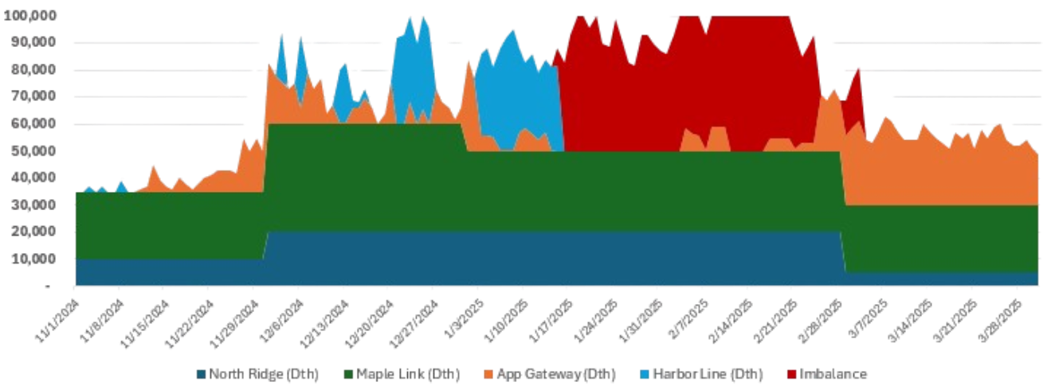
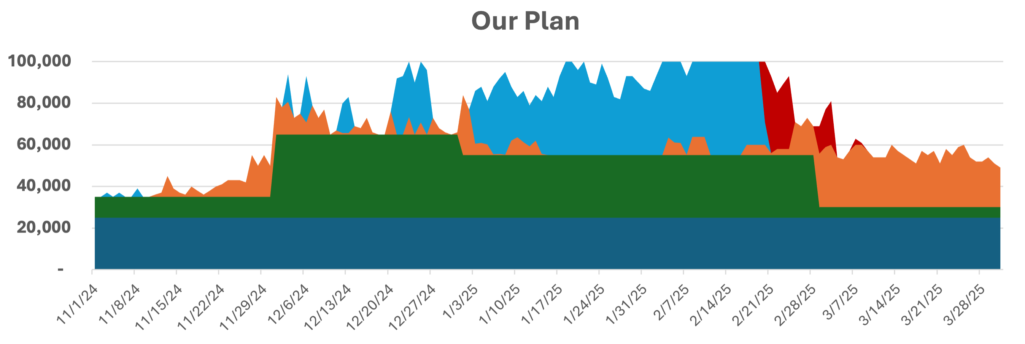
Fuel Plan Must Prioritize Reliability, Even In Extreme Circumstances
Previous Plan
Utilize the monthly bills of Maple Link to attack peak demand
Drastically increased Harbor Line Transmission as a contingency for extreme weather
Seasonal expenses to cover, minimizing excess
North Ridge Pipeline
Maple Link Transmission
Appalachian Gateway
Harbor Line Transmission
Imbalance

Slide 4

Benefits Outweigh Risks and Alternatives for Recommendation
1
2
3
Hedge LNG Further to 2.5M
Increase Appalachian in Jan/Feb
Recommended Plan
$232.71
Non-Storm
$232.14
Winter Storm Year
$202.09
Non-Storm
$238.94
Winter Storm Year
$202.71
Non-Storm
$230.08
Winter Storm Year
Benefits
High reliability
Low cost variance
Risks
Over-hedging—diminishing marginal returns
Overinvesting in LNG increases risk of stranded cost
Operating well past efficient frontier
Overburden consumer for unnecessary security
Benefits
Lower non-storm average
Less reliance on fixed costs
Risks
Too much reliance on interruptibles during most vulnerable months
Repeat of Winter Storm X, cutting of gas supply plausible
Extremely susceptible to the increase of storm frequency
Reputationally catastrophic
Cuts possibility for 15 year bond option
Risks
Potential stranded cost at $2M LNG purchase
Rigid investments in fixed pipelines
Minor imbalance remnants in Winter Storm X Model
Mitigation
Operates at efficiency frontier, between over-hedging and imbalance
Fixed pipelines enable 15 year bonds
Protected from future worsening storms (Reuters)
Imbalance solved through consumer behavior
*Costs represent Average Monthly Fuel Cost per Household
https://www.reuters.com/business/energy/us-crude-natural-gas-production-recover-after-winter-storm-ravages-output-2026-01-28/

Slide 5
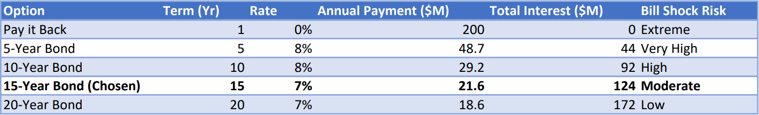
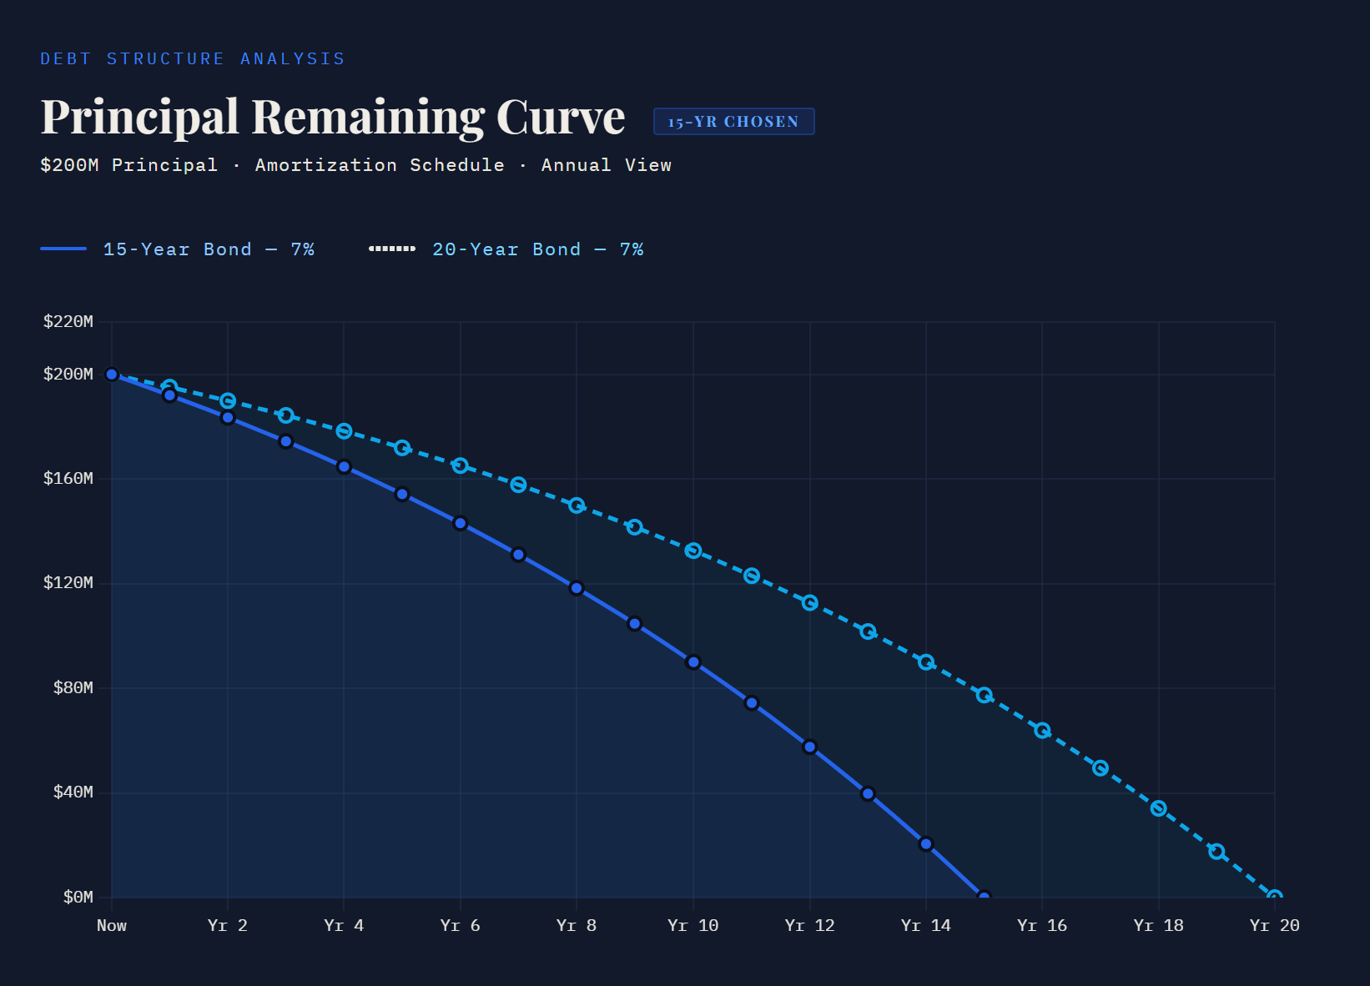
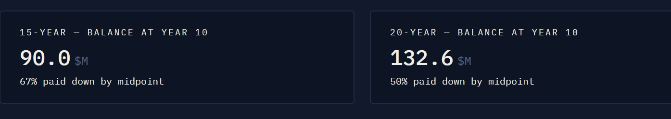
But a 15-Year Finance Structure Accelerates Debt Reduction and Reduces Long-Term Exposure

Slide 6
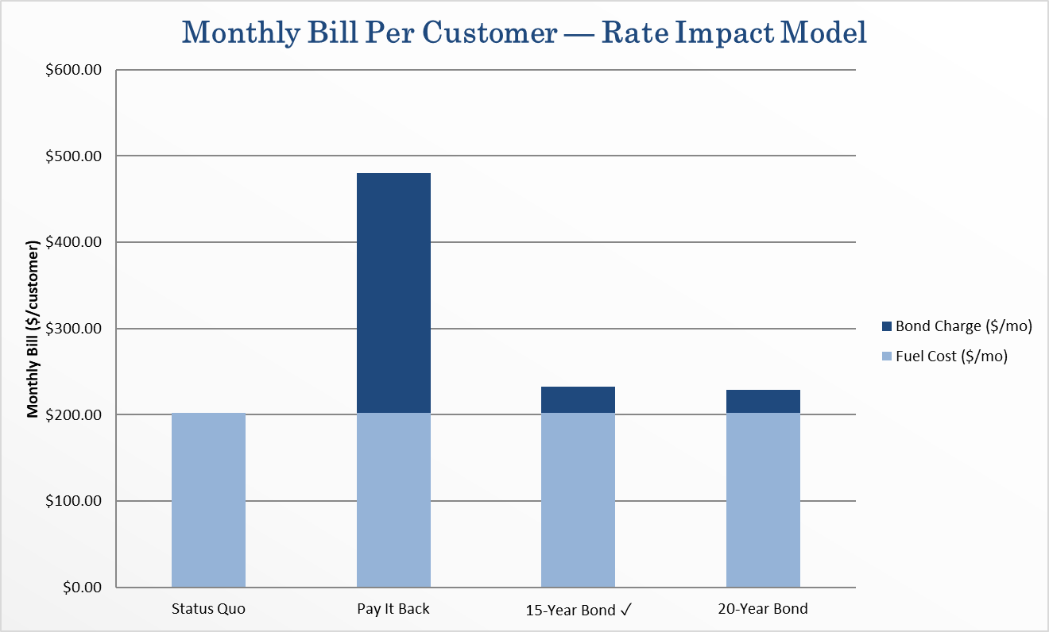
It Also Delivers Rate Stability While Protecting Customer Trust and Company Reputation
15-Year vs. 20-Year difference is negligible – only $4/month per customer (1.7%)
Customers prefer reliability over marginal savings; bill shock risks company perception far more
Status quo can't be an option: unresolved risk leads to future financial crises

Slide 7
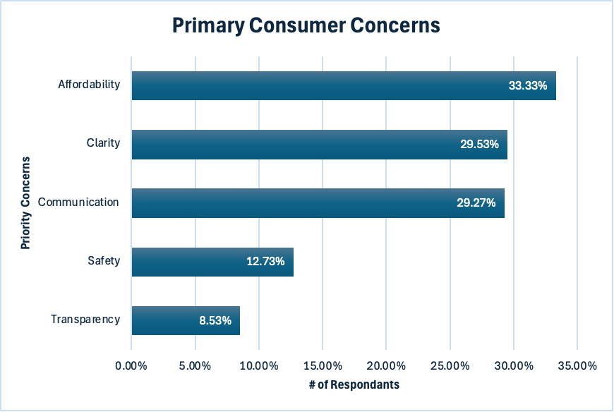
Instate a Comprehensive Communication Plan to Recover 92% of Community Trust
Publicly inform residents of the adjusted affordable fuel model and financial plan through mayoral role to recapture 33% of consumer trust
Reframe communication to consumers (transparency & clarity) utilizing plain and client first language to regain 59% of consumers trust
Send out proactively framed messages and strategically target outreach to demographics secures additional public trust

Slide 8
Next Steps
1
Another Consumer Survey
Understand marketing plan success; gather insights on non-residential stakeholders
Q2 2027
Public Outreach
2
Reevaluate Fuel Model
Adjust low risk conservative model to be more liberal with optimized risk for affordability
Operations Manager
Q3 2027
3
14% of Residents decrease energy usage by 15% to eliminate imbalance in a replica Winter Storm X
Eliminate Imbalance
Q2 2030
Public View
4
Continual Monitoring of Financial Plan
Assess the financial plan's performance
Q3 2034
Financial Officer

Slide 9
